Slide 1
CS492 - Operating Systems File System
Georgios Portokalidis & Jun Xu
ZyBook 4.2-4.5, MOS 4.1-4.2, 4.3.1-4.3.3, 4.3.7
Slides credit: Antonio Barbalace

Slide 2
File System (1)
Why File Systems? → Store information long term
Essential requirements for long-term information storage
It must be possible to store a very large amount of information
Information must survive termination of process using it
Multiple processes must be able to access information concurrently
Notes:
(1) All computer applications need to store and retrieve information. While a process is running, it can store a limited amount of information within its own address space. However, the storage capacity is restricted to the size of the virtual address space. For some applications this size is adequate, but for others, such as airline reservations, banking, or corporate record keeping, it is far too small.
(2) A second problem with keeping information within a process’ address space is that when the process terminates, the information is lost. For many applications (e.g., for databases), the information must be retained for weeks, months, or even forever. Having it vanish when the process using it terminates is unacceptable. Furthermore, it must not go away when a computer crash kills the process.
(3) A third problem is that it is frequently necessary for multiple processes to access (parts of) the information at the same time. If we have an online telephone directory stored inside the address space of a single process, only that process can access it. The way to solve this problem is to make the information itself independent
of any one process.

Slide 3
File System (2)
Storage devices
Mechanical rotating disk
Solid state drive
Tape
Optical disks
Think of a disk as a linear sequence of fixed-size blocks and supporting (at least) two operations
Read block k
Write block k
Notes:
In reality there are more, but with these two operations one could, in principle, solve the long-term storage problem.

Slide 4
File System (3)
Questions
How do you find information?
How do you keep one user from reading another user’s data?
How do you know which blocks are free?

Slide 5
Files

Slide 6
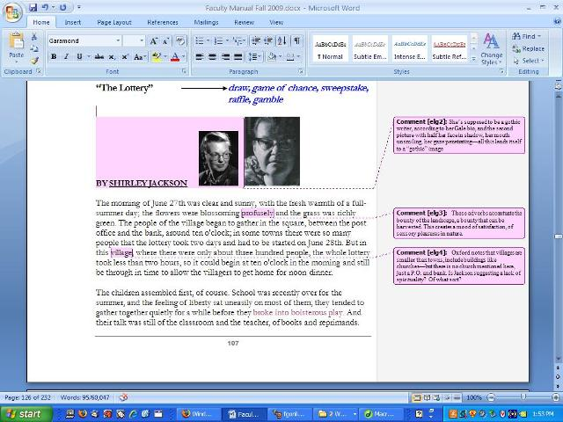

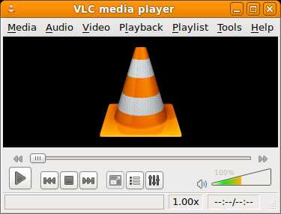

The File Abstraction
A file is an abstraction
The OS abstracts away the concept of disk to offer files
Shield the user from the details about storage
Process, abstracts physical CPU
Address space, abstracts physical memory
File, abstracts disk
Notes:
Just as we saw how the operating system abstracted away the concept of the processor to create the abstraction of a process and how it abstracted away the concept of physical memory to offer processes (virtual) address spaces, we can solve this problem with a new abstraction: the file.
A disk will usually contain thousands or even millions of them, each one independent of the others. In fact, if you think
of each file as a kind of address space, you are not that far off, except that they are used to model the disk instead of modeling the RAM.
Files are managed by the operating system. How they are structured, named, accessed, used, protected, implemented, and managed are major topics in operating system design. As a whole, that part of the operating system dealing with files is known as the file system and is the subject of this chapter.
From the user’s standpoint, the most important aspect of a file system is how it appears, in other words, what constitutes a file, how files are named and protected, what operations are allowed on files, and so on. The details of whether linked lists or bitmaps are used to keep track of free storage and how many sectors there are in a logical disk block are of no interest, although they are of great importance to the designers of the file system. For this reason, we have structured the chapter as several sections. The first two are concerned with the user interface to files and directories, respectively. Then comes a detailed discussion of how the file system is implemented and managed. Finally, we give some examples of real file systems

Slide 7
The File Abstraction
A file is an abstraction
The OS abstracts away the concept of disk to offer files
Shield the user from the details about storage
Logical units of information created by processes
A disk contains thousands or even millions of them
Each one independent of the others
Files are managed by the operating system
The file system is the subsystem that deal with this subject
Notes:
Just as we saw how the operating system abstracted away the concept of the processor to create the abstraction of a process and how it abstracted away the concept of physical memory to offer processes (virtual) address spaces, we can solve this problem with a new abstraction: the file.
A disk will usually contain thousands or even millions of them, each one independent of the others. In fact, if you think
of each file as a kind of address space, you are not that far off, except that they are used to model the disk instead of modeling the RAM.
Files are managed by the operating system. How they are structured, named, accessed, used, protected, implemented, and managed are major topics in operating system design. As a whole, that part of the operating system dealing with files is known as the file system and is the subject of this chapter.
From the user’s standpoint, the most important aspect of a file system is how it appears, in other words, what constitutes a file, how files are named and protected, what operations are allowed on files, and so on. The details of whether linked lists or bitmaps are used to keep track of free storage and how many sectors there are in a logical disk block are of no interest, although they are of great importance to the designers of the file system. For this reason, we have structured the chapter as several sections. The first two are concerned with the user interface to files and directories, respectively. Then comes a detailed discussion of how the file system is implemented and managed. Finally, we giv e some examples of real file systems

Slide 8
File Naming
Different file systems have different limitations/conventions for file names
File extensions
File name length
FAT: 8.3 characters (later extended to 255)
EXT4: 255 characters
Special characters in file names
FAT: No "*/:<>?\| and more
EXT4: No '\0' and '/' or the special names "." and ".."
Case sensitivity
Notes:
When a process creates a file, it gives the file a name. When the process terminates, the file continues to exist and can be accessed by other processes using its name.
In UNIX, file extensions are just conventions and are not enforced by the operating system. (But for example by the compiler.)

Slide 9
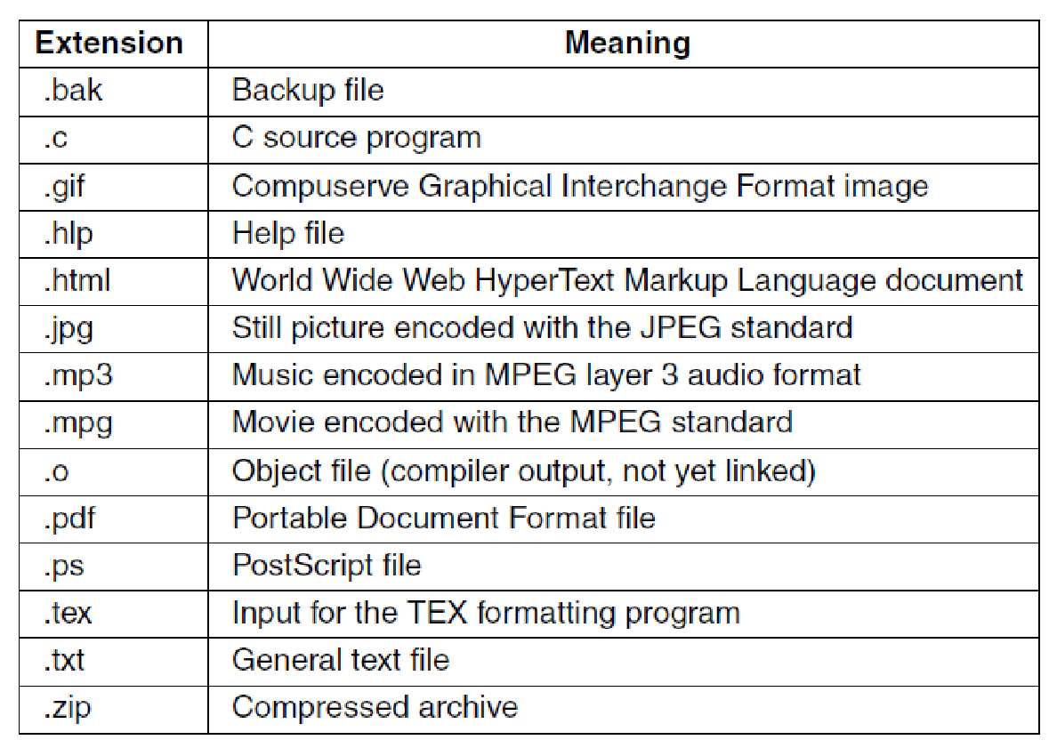
File Extensions
Windows
Each extension corresponds to a file type → Determines how a file should be opened
Unix
Extensions are just conventions → Sometimes determine how a file should be opened
Some typical file extensions. (MOS Figure 4-1.)
Notes:
When a process creates a file, it gives the file a name. When the process terminates, the file continues to exist and can be accessed by other processes using its name.
In UNIX, file extensions are just conventions and are not enforced by the operating system. (But for example by the compiler.)

Slide 10
File Structure
OS’ perspective: Files as streams of bytes
Program’s perspective: Archives, Executables, etc.

Slide 11
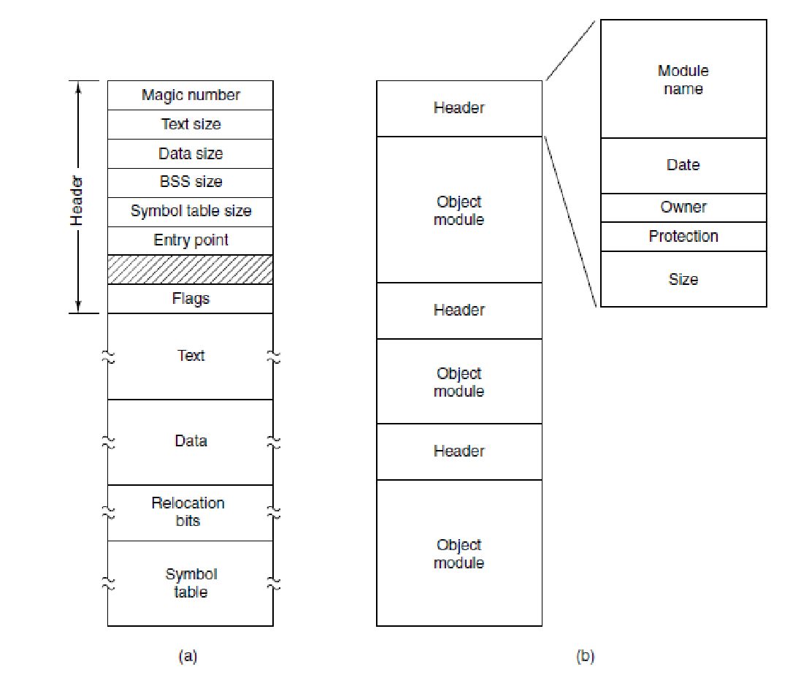
File Types
Regular files
User information
ASCII, binary
Directories
Structure of the file system
Soft links
Character special files
Model serial I/O
Block special files
Model disk
Regular files. (a) An executable file. (b) An archive. (MOS Figure 4-3.)

Slide 12
File Access
Sequential access
Seek pointer (e.g., tapes)
Random access
Read block or bytes out of order (e.g., disk)
Notes:
Early operating systems provided only one kind of file access: sequential access. In these systems, a process could read all the bytes or records in a file in order, starting at the beginning, but could not skip around and read them out of order. Sequential files could be rewound, however, so they could be read as often as needed. Sequential files were convenient when the storage medium was magnetic tape rather than disk

Slide 13
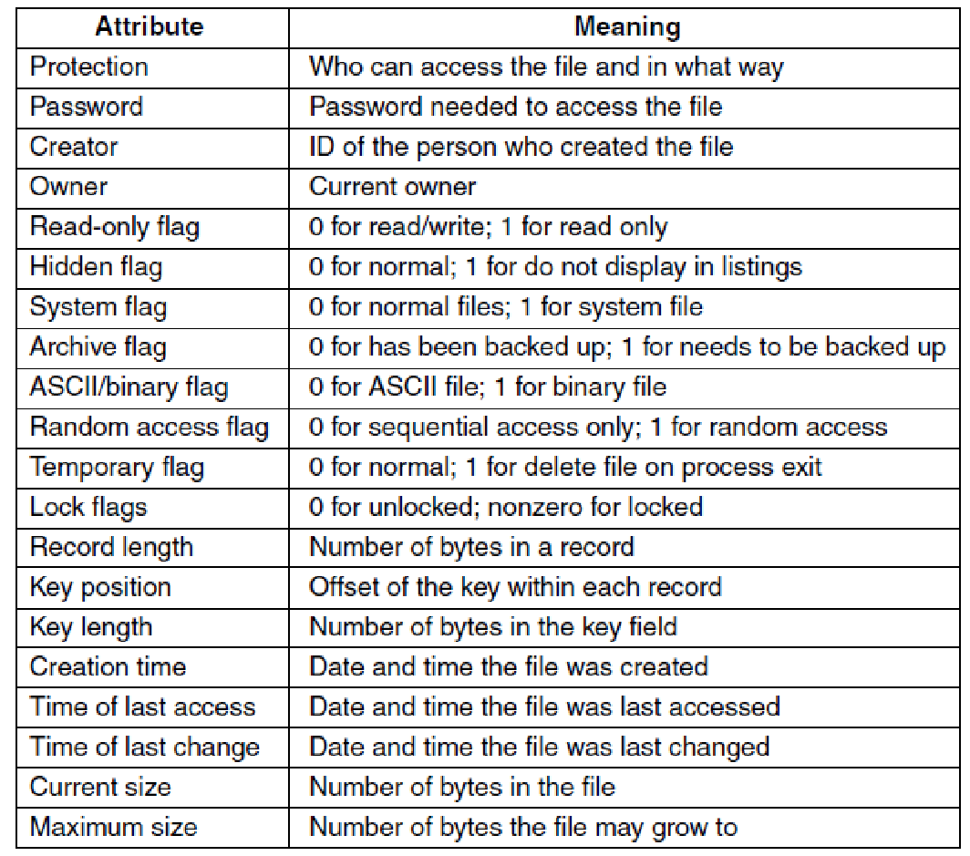
File Attributes (or Metadata)
Some possible file attributes. (MOS Figure 4-4)

Slide 14
File Operations
Files exist to store information and allow it to be retrieved later.
Create
Delete
Open
Close
Read
Write
Append
Seek
Get attributes
Set attributes
Rename
Notes:
1. Create. The file is created with no data. The purpose of the call is to
announce that the file is coming and to set some of the attributes.
2. Delete. When the file is no longer needed, it has to be deleted to free
up disk space. There is always a system call for this purpose.
3. Open. Before using a file, a process must open it. The purpose of the
open call is to allow the system to fetch the attributes and list of disk
addresses into main memory for rapid access on later calls.
4. Close. When all the accesses are finished, the attributes and disk addresses
are no longer needed, so the file should be closed to free up
internal table space. Many systems encourage this by imposing a
maximum number of open files on processes. A disk is written in
blocks, and closing a file forces writing of the file’s last block, even
though that block may not be entirely full yet.
5. Read. Data are read from file. Usually, the bytes come from the current
position. The caller must specify how many data are needed and
must also provide a buffer to put them in.
6. Write. Data are written to the file again, usually at the current position.
If the current position is the end of the file, the file’s size increases.
If the current position is in the middle of the file, existing
data are overwritten and lost forever.
7. Append. This call is a restricted form of wr ite. It can add data only to
the end of the file. Systems that provide a minimal set of system calls
rarely have append, but many systems provide multiple ways of
doing the same thing, and these systems sometimes have append.
8. Seek. For random-access files, a method is needed to specify from
where to take the data. One common approach is a system call, seek,
that repositions the file pointer to a specific place in the file. After this
call has completed, data can be read from, or written to, that position.
9. Get attributes. Processes often need to read file attributes to do their
work. For example, the UNIX make program is commonly used to
manage software development projects consisting of many source
files. When make is called, it examines the modification times of all
the source and object files and arranges for the minimum number of
compilations required to bring everything up to date. To do its job, it
must look at the attributes, namely, the modification times.
10. Set attributes. Some of the attributes are user settable and can be
changed after the file has been created. This system call makes that
possible. The protection-mode information is an obvious example.
Most of the flags also fall in this category.
11. Rename. It frequently happens that a user needs to change the name
of an existing file. This system call makes that possible. It is not always
strictly necessary, because the file can usually be copied to a
new file with the new name, and the old file then deleted.

Slide 15
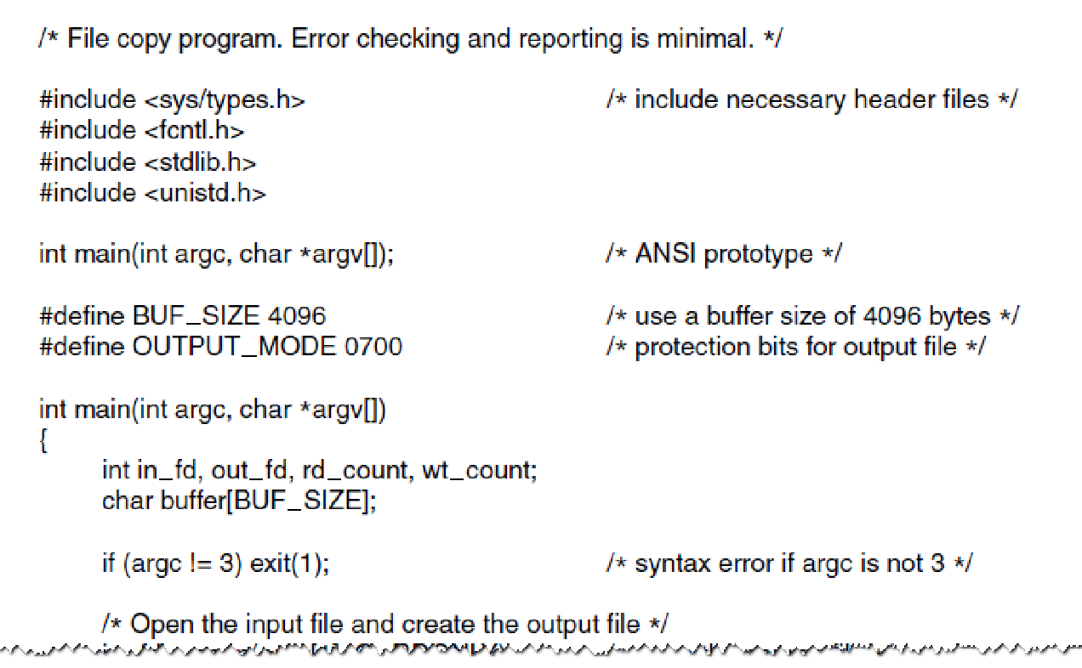
Example Program Using File System Calls (1)
A simple program to copy a file.

Slide 16
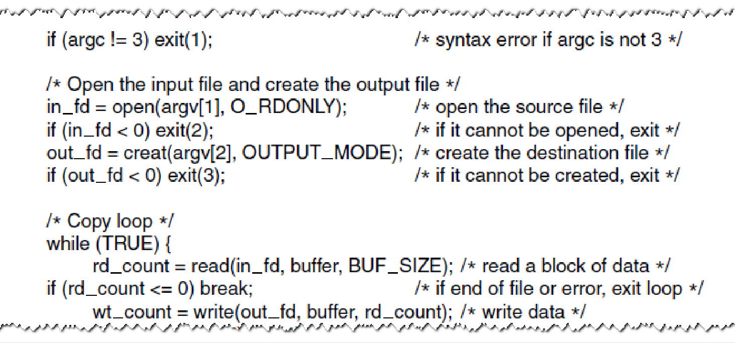
Example Program Using File System Calls (2)
A simple program to copy a file.

Slide 17
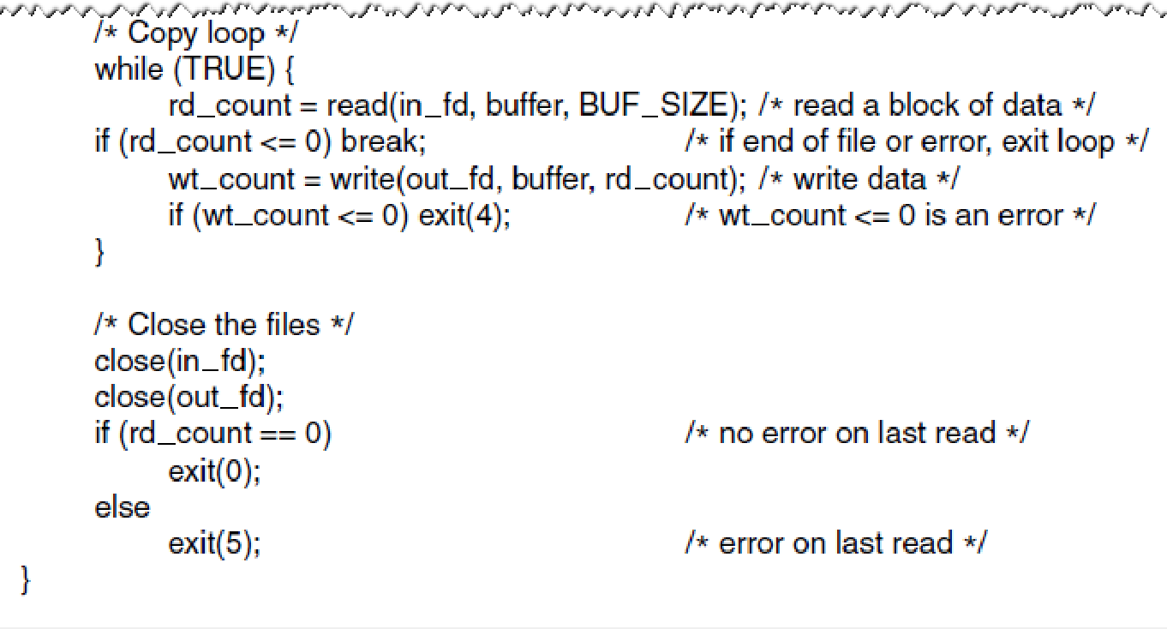
Example Program Using File System Calls (3)
A simple program to copy a file.

Slide 18
Directories (or Folders)

Slide 19
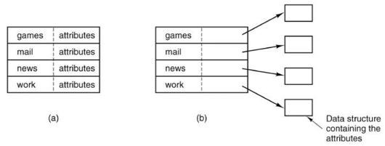
Directories (or Folders)
Persistent data structures organizing and maintaining information about files (entries)
Are files themselves
File attributes stored in-band or out-of-band:
Both in common use in modern file systems
Organizations
Single-level
Hierarchical

Slide 20
Directories (or Folders)
Persistent data structures organizing and maintaining information about files (entries)
Are files themselves
File attributes stored in-band or out-of-band:
Both in common use in modern file systems
Organization
Single-level
Hierarchical

Slide 21
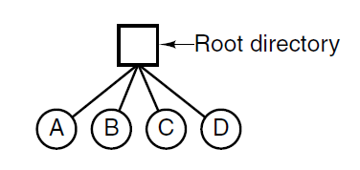
Single-Level Directory Systems
Simplest form
Single root directory
Flat file system
Legacy solution
A single-level directory system containing four files. (MOS Figure 4-6.)

Slide 22
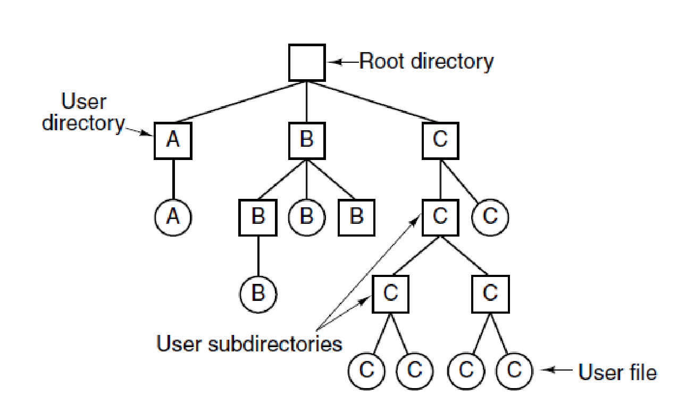
Hierarchical Directory Systems
Directory
File
A hierarchical directory system with three users (A, B, C). (MOS Figure 4-7.)

Slide 23
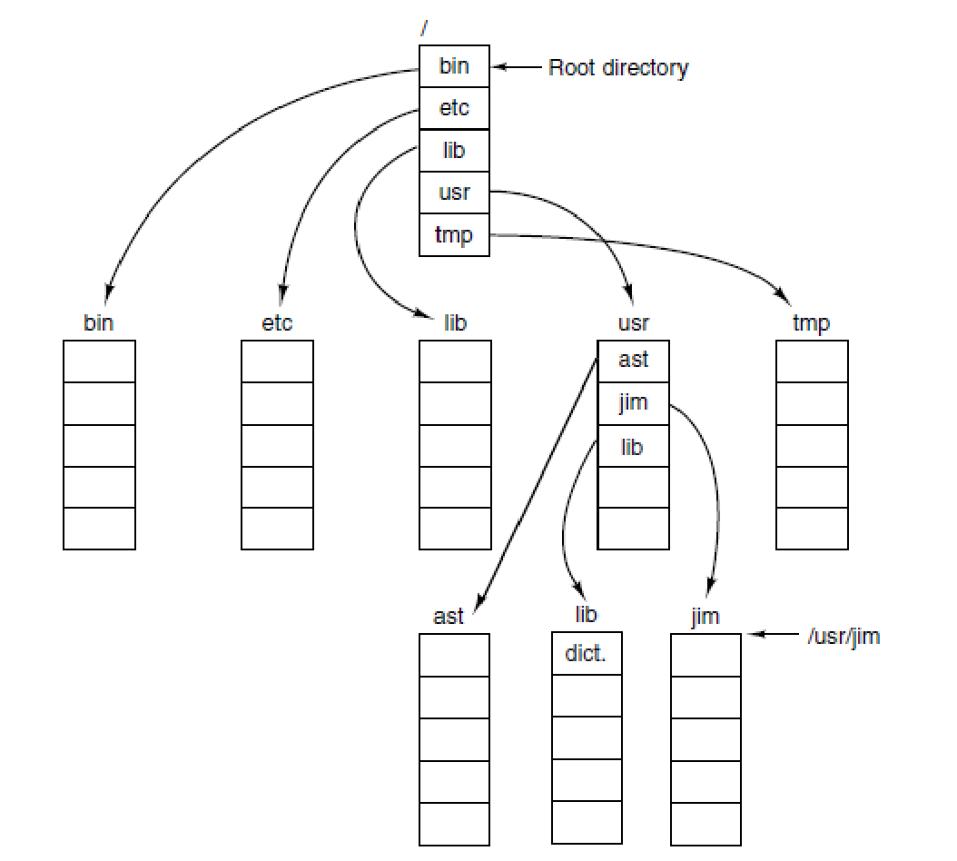
Path Names
Hierarchical directory
How to name the location of a file?
Path
Name
Separator (\, /, >, …)
Current (working) directory
Examples
Windows \usr\ast
UNIX /usr/ast
MULTICS >usr>ast
A UNIX directory tree. (MOS Figure 4-8.)

Slide 24
Directory Operations
Create
.
..
Delete
Opendir
Closedir
Readdir
Rename
Link
Hard
Soft
Unlink
Notes:
1. Create. A directory is created. It is empty except for dot and dotdot,
which are put there automatically by the system (or in a few cases, by
the mkdir program).
2. Delete. A directory is deleted. Only an empty directory can be deleted.
A directory containing only dot and dotdot is considered empty
as these cannot be deleted.
3. Opendir. Directories can be read. For example, to list all the files in a
directory, a listing program opens the directory to read out the names
of all the files it contains. Before a directory can be read, it must be
opened, analogous to opening and reading a file.
4. Closedir. When a directory has been read, it should be closed to free
up internal table space.
5. Readdir. This call returns the next entry in an open directory. Formerly,
it was possible to read directories using the usual read system
call, but that approach has the disadvantage of forcing the programmer
to know and deal with the internal structure of directories.
In contrast, readdir always returns one entry in a standard format, no
matter which of the possible directory structures is being used.
6. Rename. In many respects, directories are just like files and can be
renamed the same way files can be.
7. Link. Linking is a technique that allows a file to appear in more than
one directory. This system call specifies an existing file and a path
name, and creates a link from the existing file to the name specified
by the path. In this way, the same file may appear in multiple directories.
A link of this kind, which increments the counter in the file’s
i-node (to keep track of the number of directory entries containing the
file), is sometimes called a hard link.
8. Unlink. A directory entry is removed. If the file being unlinked is
only present in one directory (the normal case), it is removed from the
file system. If it is present in multiple directories, only the path name
specified is removed. The others remain. In UNIX, the system call
for deleting files (discussed earlier) is, in fact, unlink.

Slide 25
File System Implementation
Notes:
Now it is time to turn from the user’s view of the file system to the implementor’s
view. Users are concerned with how files are named, what operations are
allowed on them, what the directory tree looks like, and similar interface issues.
Implementers are interested in how files and directories are stored, how disk space
is managed, and how to make everything work efficiently and reliably. In the following
sections we will examine a number of these areas to see what the issues and
trade-offs are.

Slide 26
File System (1)
Application
The File system consists of
The OS’ File system subsystem organized into layers
The File system data (including metadata) stored in storage (disks)
Operating
System
File System
Subsystem
CPU
File System
Disk
Hardware

Slide 27
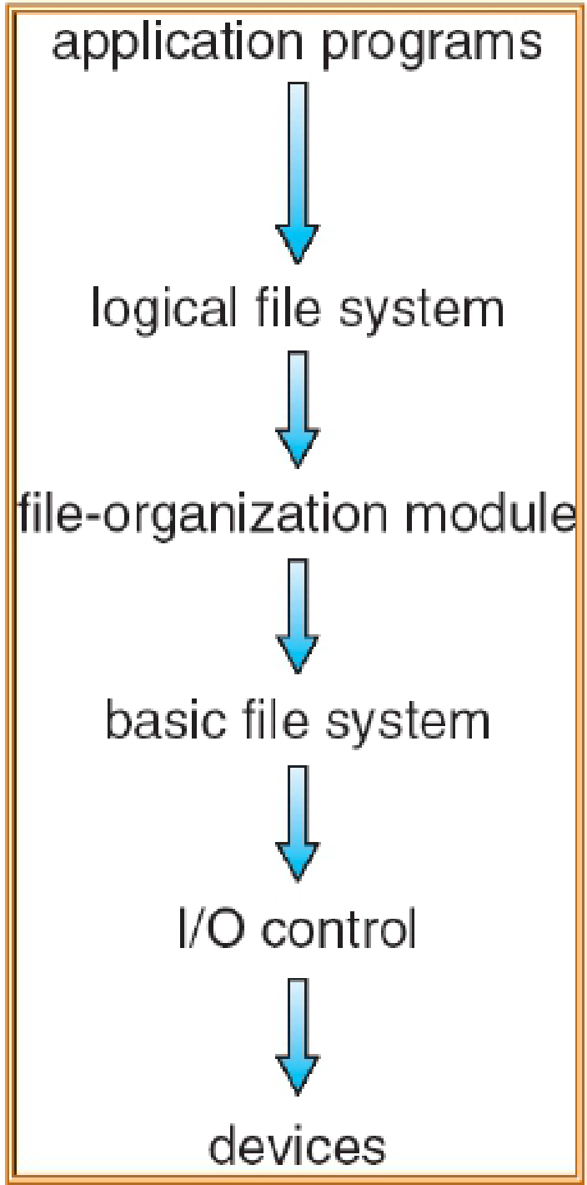
File System (2)
The File system consists of
The OS’ File system subsystem organized into layers
The File system data (including metadata) stored in storage (disks)
Layered OS’ file system subsystem organization
Operating System
Device
Driver

Slide 28
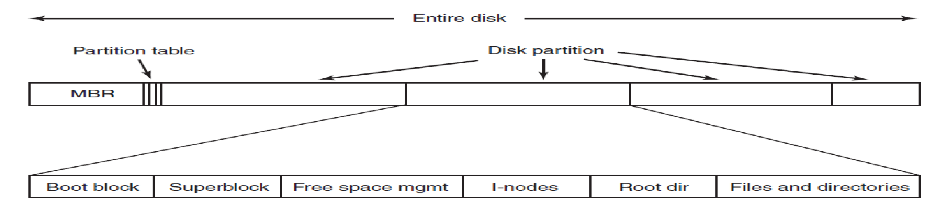
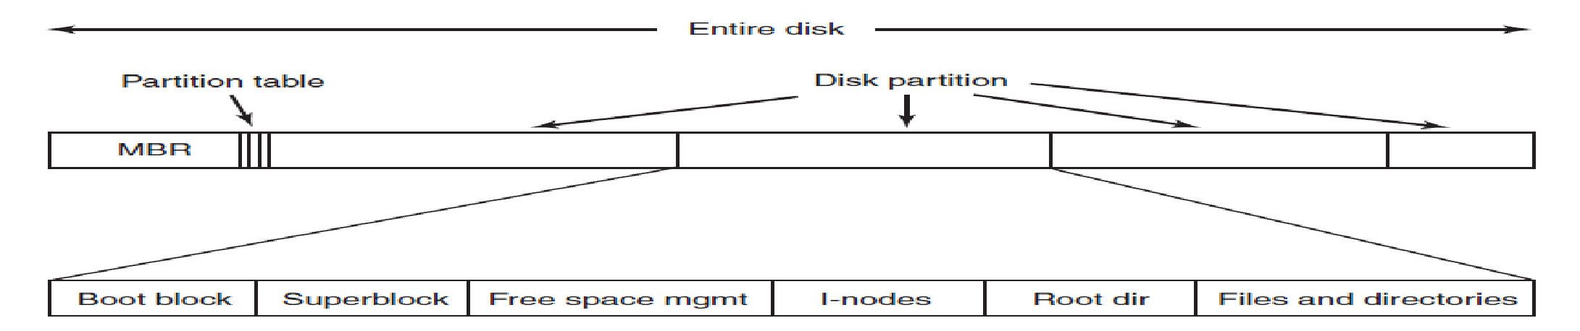
Disk and File System Layout
A disk can be divided up into more partitions
Each with an independent file system
Master
Boot
Record
A possible disk and file system layout. (MOS Figure 4-9.)
Notes:
MBR (Master Boot Record) used to boot the computer
The end of the MBR contains the partition table. This table gives the starting and
ending addresses of each partition. One of the partitions in the table is marked as
active. When the computer is booted, the BIOS reads in and executes the MBR.
The first thing the MBR program does is locate the active partition, read in its first
block, which is called the boot block, and execute it.
The program in the boot block loads the operating system contained in that partition. For uniformity, every partition starts with a boot block, even if it does not contain a bootable operating system. Besides, it might contain one in the future. Other than starting with a boot block, the layout of a disk partition varies a lot from file system to file system. Often the file system will contain some of the items shown in Fig. 4-9. The first one is the superblock. It contains all the key parameters about the file system and is read into memory when the computer is booted or the file system is first touched. Typical information in the superblock includes a magic number to identify the file-system type, the number of blocks in the file system, and other key administrative information.
Next might come information about free blocks in the file system, for example
in the form of a bitmap or a list of pointers. This might be followed by the i-nodes,
an array of data structures, one per file, telling all about the file. After that might
come the root directory, which contains the top of the file-system tree. Finally, the
remainder of the disk contains all the other directories and files.

Slide 29
Allocation Methods
Four allocation methods
Contiguous allocation
Linked allocation
Linked allocation with Table
Indexed allocation

Slide 30
Addressing
Units: A block is the minimal unit of allocation
Physical address: some kind of tuple that identifies a block on disk
track/sector
cylinder/platter/sector
Drivers translate physical addresses to block addresses
Absolute, from block zero (easier)
Disks/storage with Logical Block Addressing expose block addresses (instead of track/sector, etc.)
Size of blocks on disk (physical) may differ from block size used by OS (logical)
Logical file address (LA)
In bytes
Relative to the beginning of the file (address 0)

Slide 31
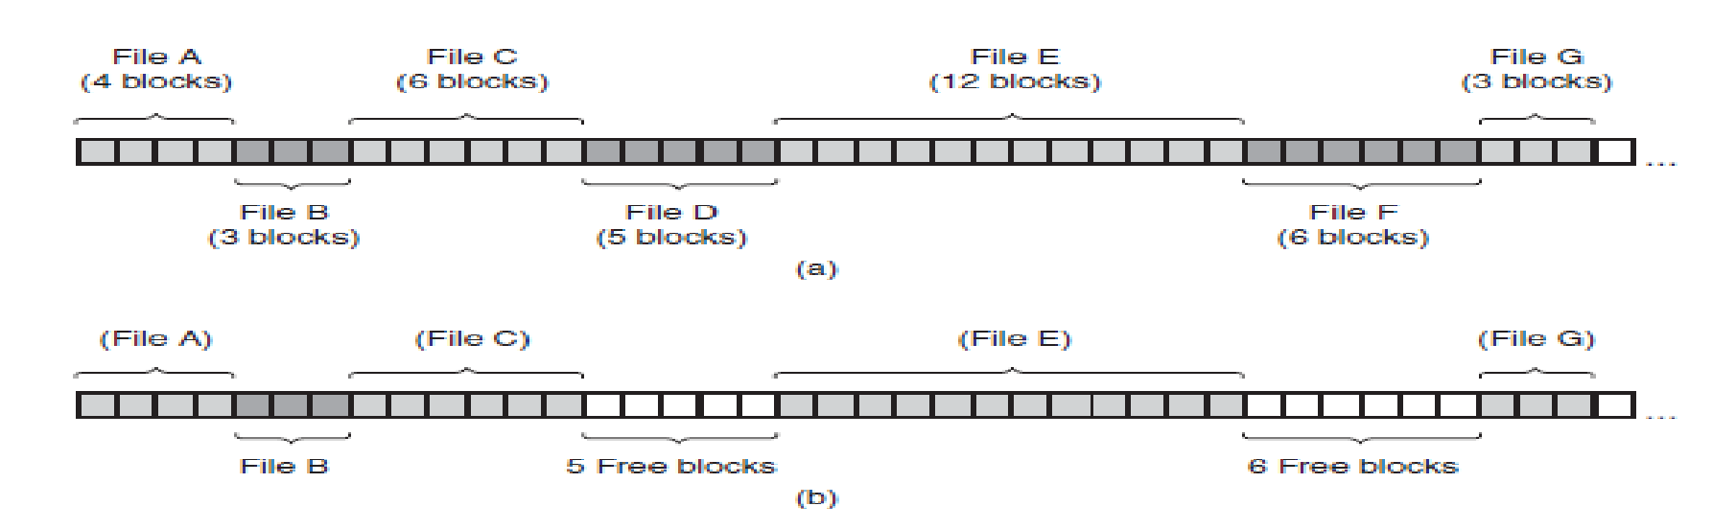
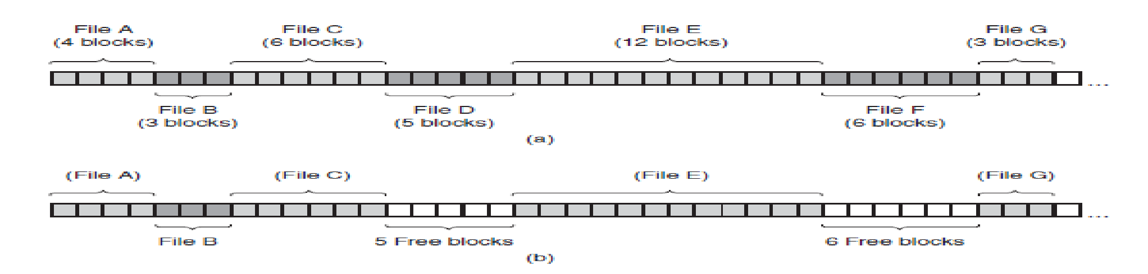
Contiguous Allocation (1)
Each file occupies a set of contiguous blocks
Entire blocks are used independently of the file size
(a) Contiguous allocation of disk space for seven files. (b) The state of the disk after files D and F have been removed.

Slide 32
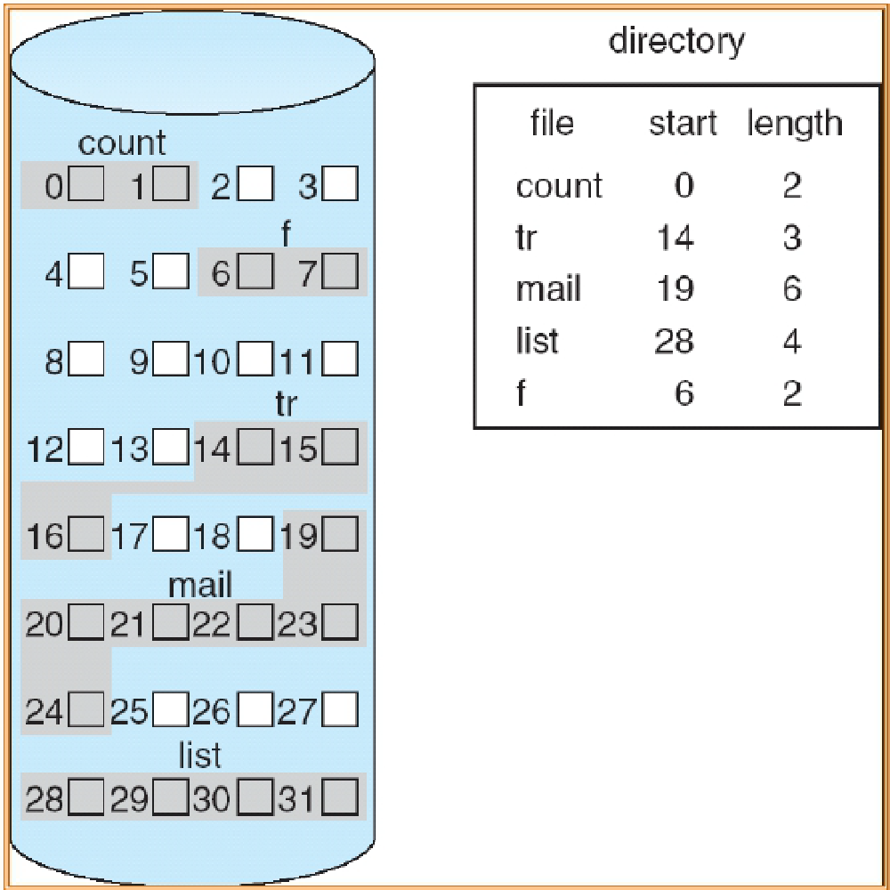
Contiguous Allocation (2)
Pros
Simple
only starting location (block #) and length (# of blocks)
Performance
The entire file can be read in a single operation
Excellent random access
Cons
Wasteful of space
External fragmentation, may need to compact space
Files cannot grow
Need to know the final size upfront

Slide 33
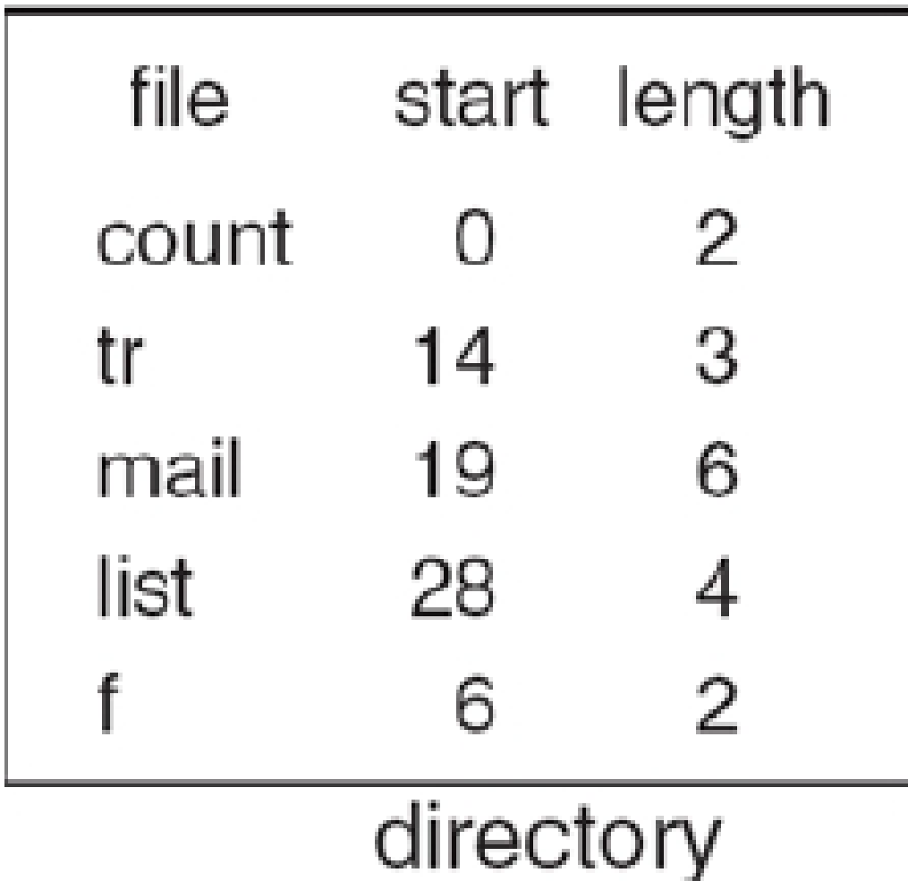
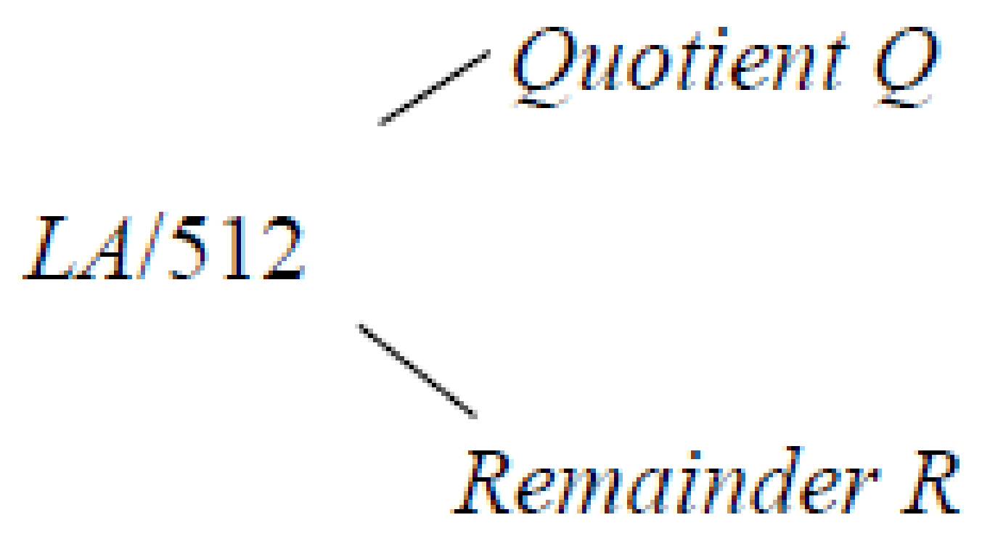
Contiguous Allocation - Example
Given a logical address LA of file A, how to map LA to its block address?
Suppose the block size is 512 bytes
Block number B = Q + starting address of file A in directory
Block offset (of LA) D = R
Number of accesses to get the data at address LA
1 access to get starting address of file A
1 access for reading data in block B

Slide 34
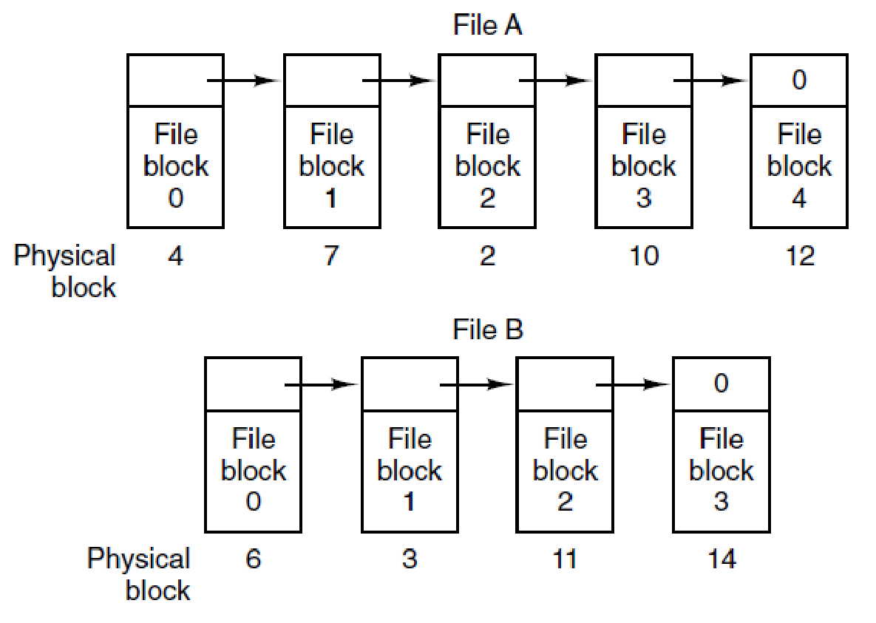
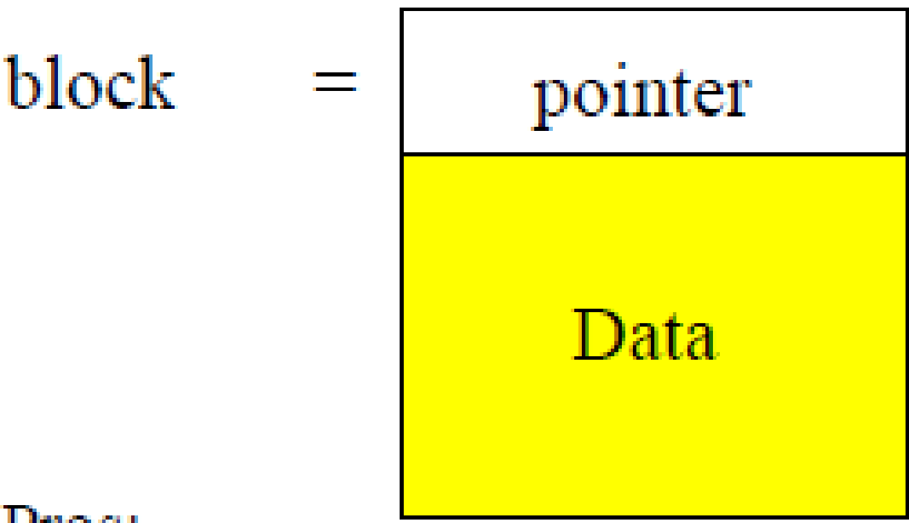
Linked List Allocation (1)
Each file is a linked list of disk blocks
First bytes of the block contain a pointer to the next block
Blocks may be scattered anywhere on the disk
-1
-1
Storing a file as a linked list of disk blocks. (MOS Figure 4-11)

Slide 35
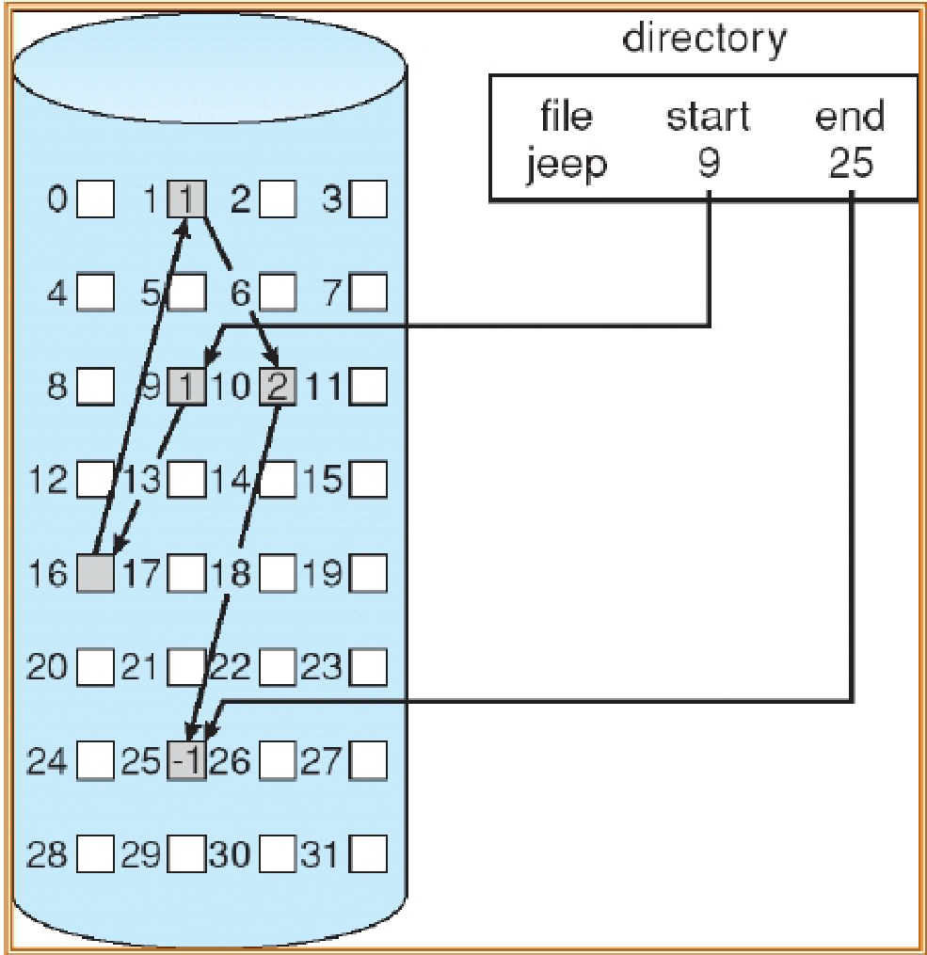
Linked List Allocation (2)
Pros
Simple
need only starting address
Free-space management system
no waste of space
Cons
No efficient random access
No power of two block data size (less efficient)
10
16
25
1

Slide 36
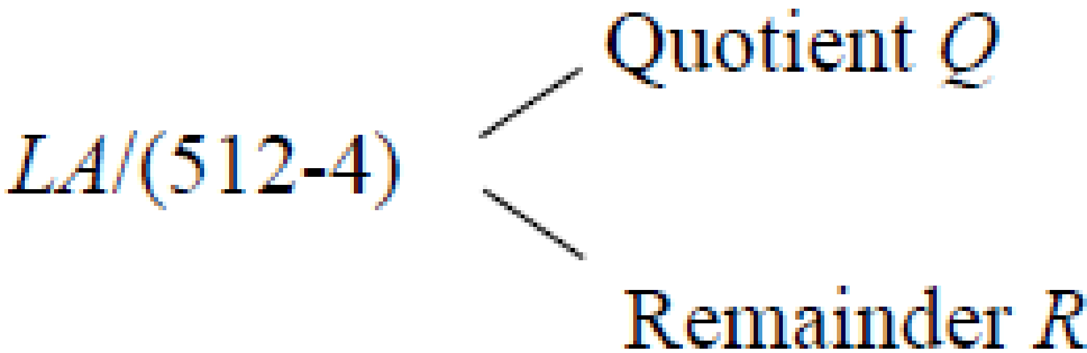
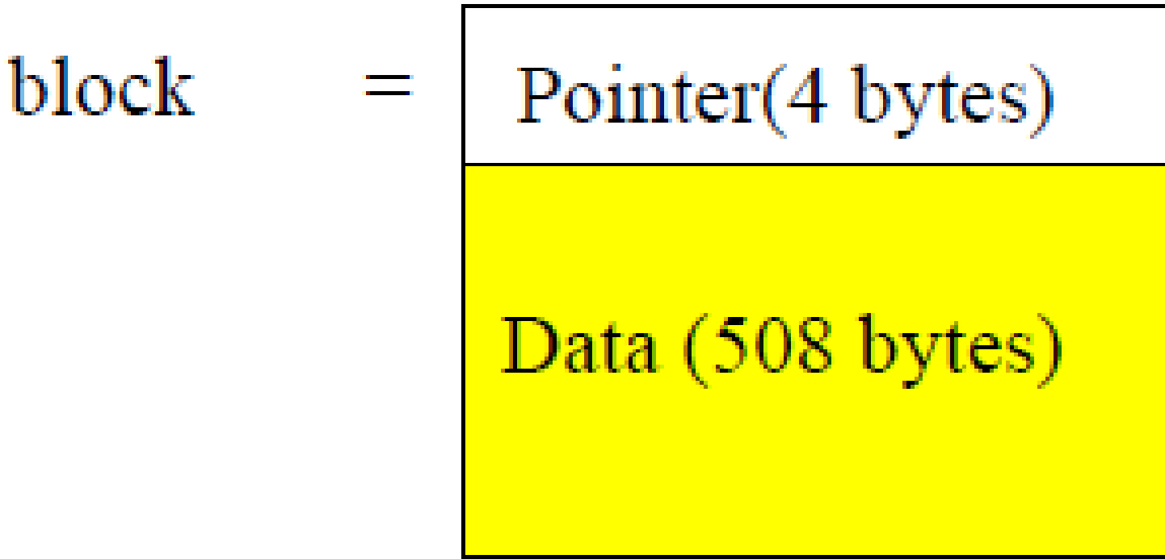
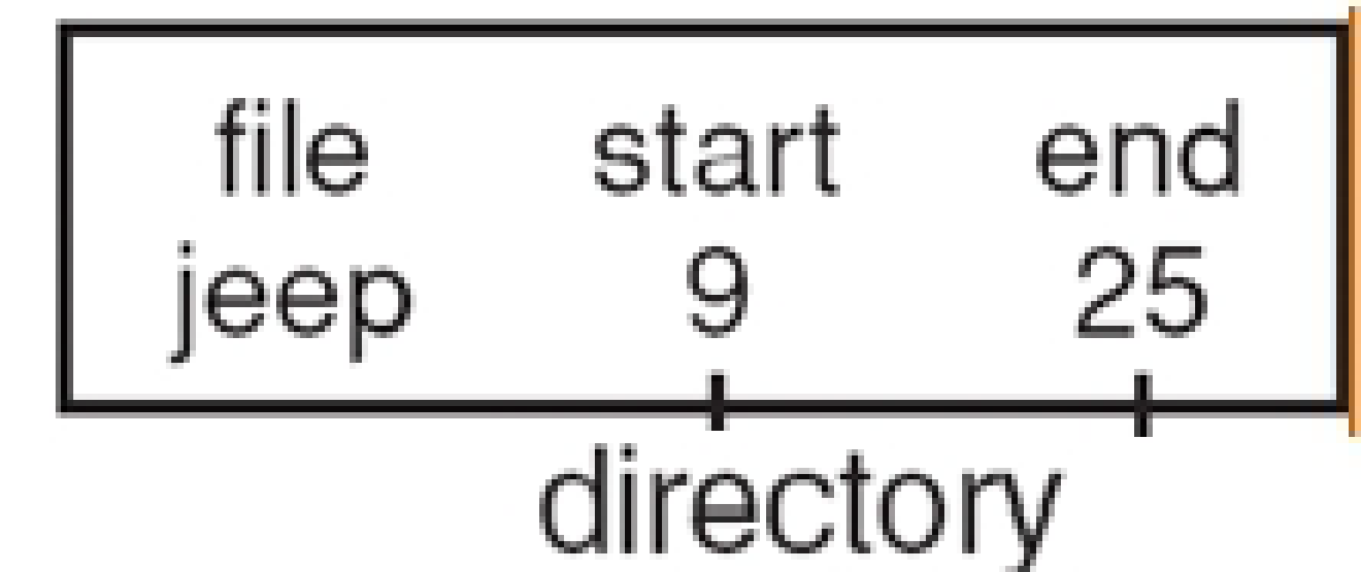
Linked List Allocation - Example
Given a logical address LA of file A, how to map LA to its block address?
Suppose block size is 512 bytes and each block contains 4 bytes reserved for pointer to next block
Block number B = Qth block in the linked chain of blocks, starting from the start block in directory
Block offset D = R + 4
Number of accesses to get the data at address LA
1 access to get starting block of file A
Q accesses for traversing Q blocks

Slide 37
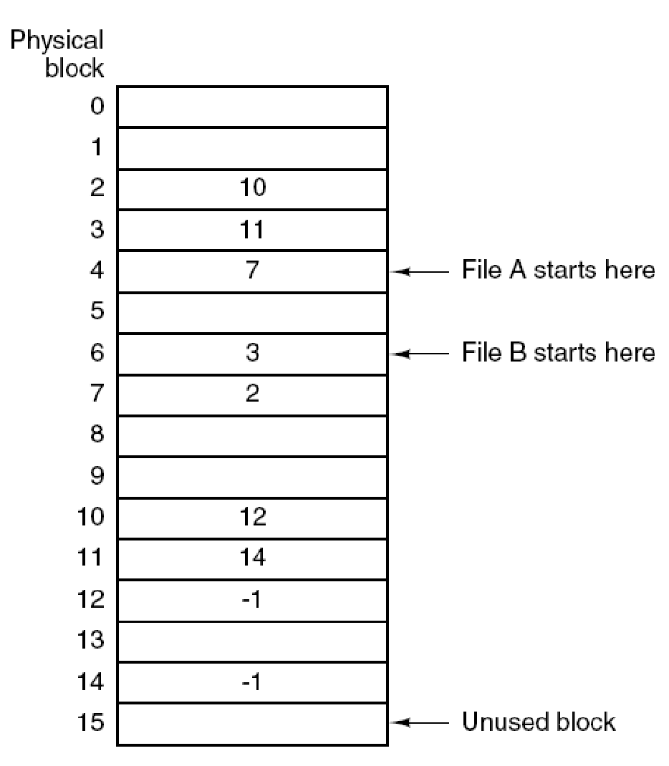
Linked-List Allocation with Table (1)
Variant of linked list allocation → File-Allocation Table (FAT)
Keep a table in memory, each entry
corresponds to disk block number
contains a pointer to the next block or -1
(Information about all files on the disk)
Linked list allocation using a file allocation table in main memory (MOS Figure 4-12.)

Slide 38
Linked-List Allocation with Table (2)
Pros
Faster random access
Cons
Entire table must be in memory
Huge problem for large disks

Slide 39
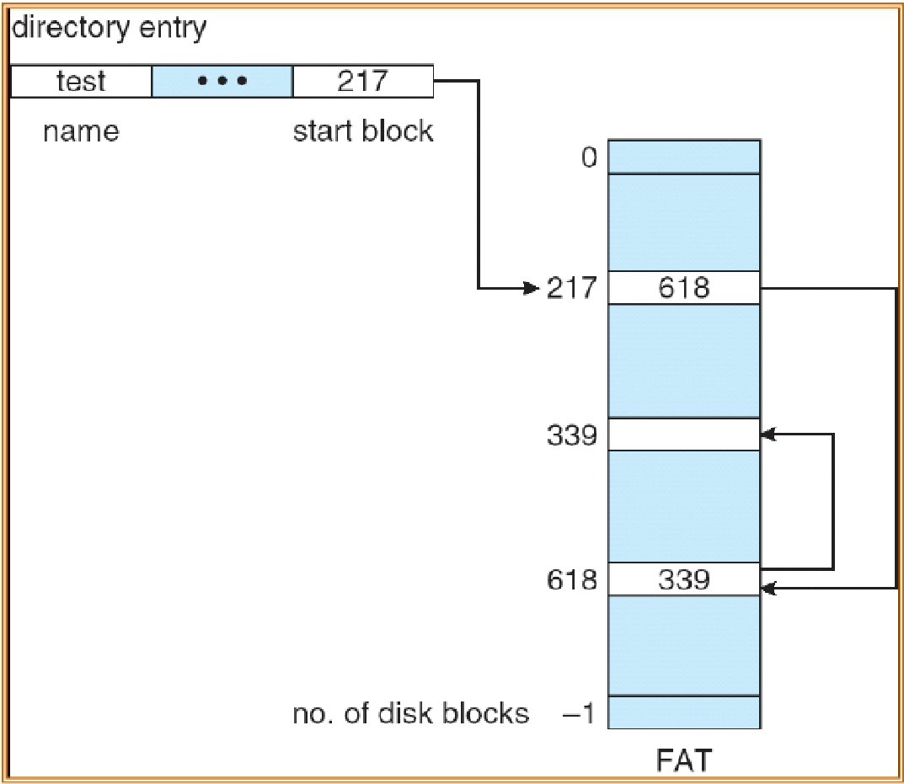
Linked-List Allocation with Table (2)
Pros
Faster random access
Cons
Entire table must be in memory
Huge problem for large disks

Slide 40
Linked List Allocation with Table - Example
Given a logical address LA of file A, how to map LA to its block address?
Suppose the block size is 512 bytes
Block number B = Qth block in the linked chain of blocks, starting from the start block in directory
Block offset D = R
Number of accesses to get the data at address LA
1 access to get starting address of file A
Q memory (FAT) accesses to get B
1 access for reading data from block B
file | start | end
A | 7 | 12

Slide 41
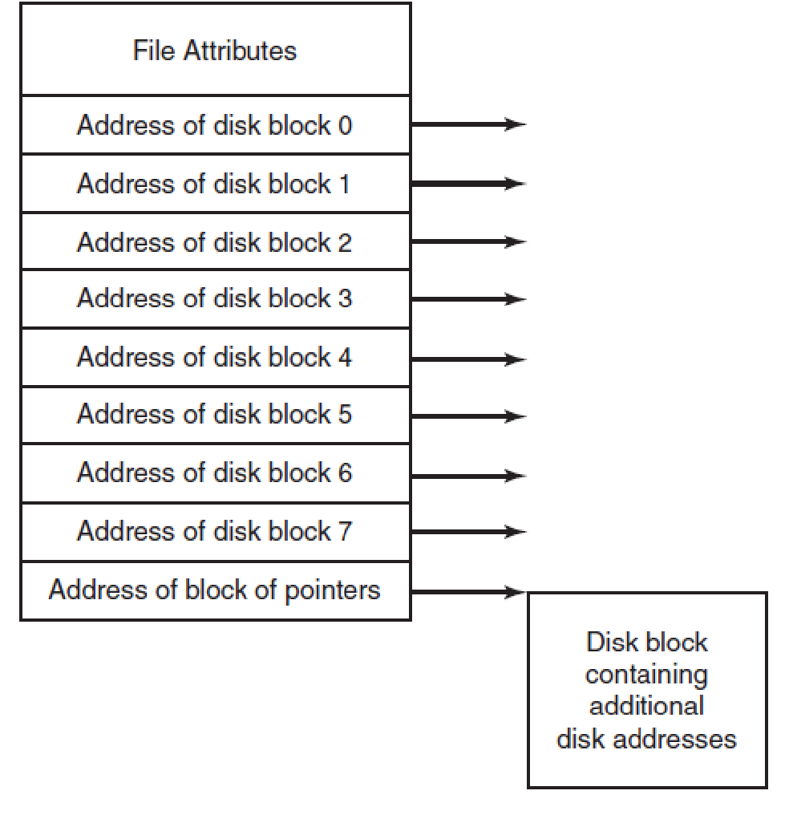
Indexed Allocation (1)
Associate a data structure (block size) called index-node (i-node) to each file
Lists the attributes
Lists the disk’s address of the file’s blocks
i-nodes may chain
(also i-node)
An example i-node. (MOS Figure 4-13.)

Slide 42
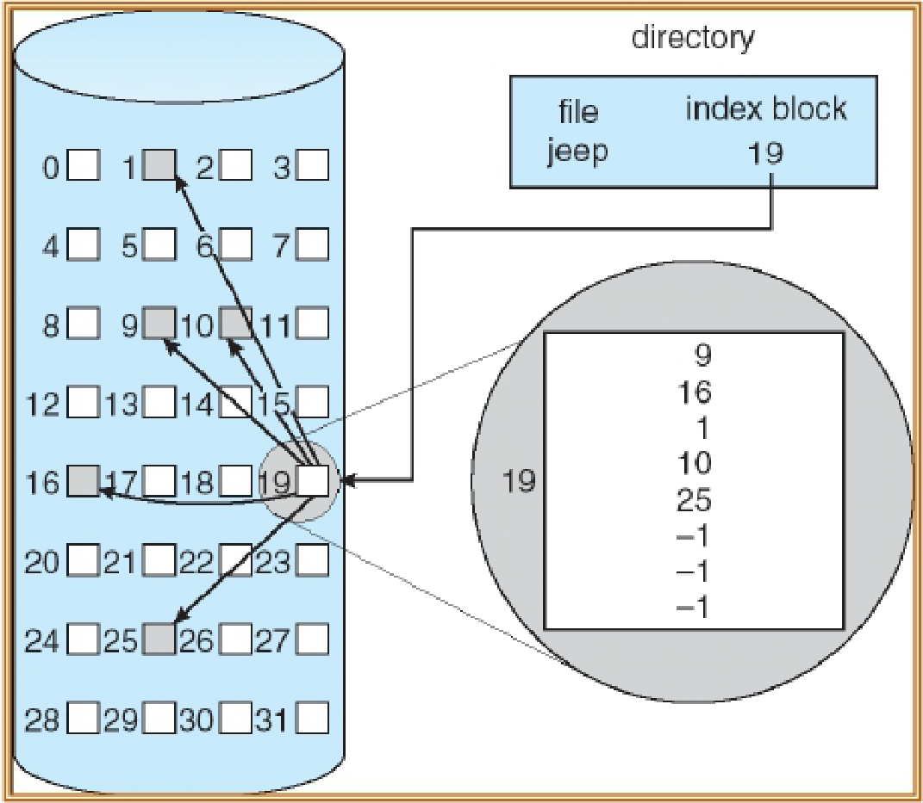
Indexed Allocation (2)
Pros
Efficient random access
Dynamic access without external fragmentation
Lower overhead than FAT
Cons
How to support large files? (that do not fit the i-node)

Slide 43
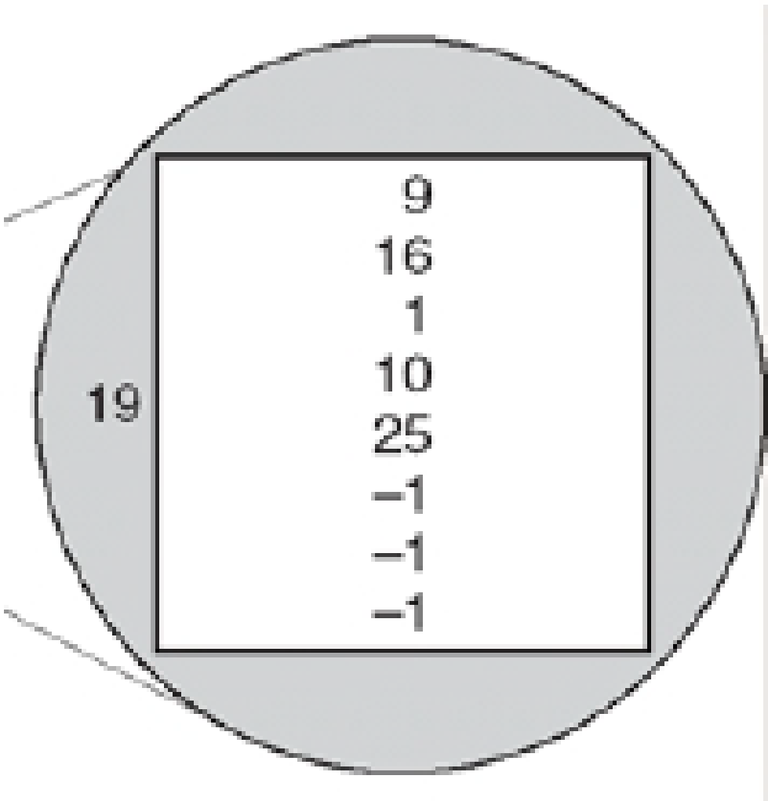
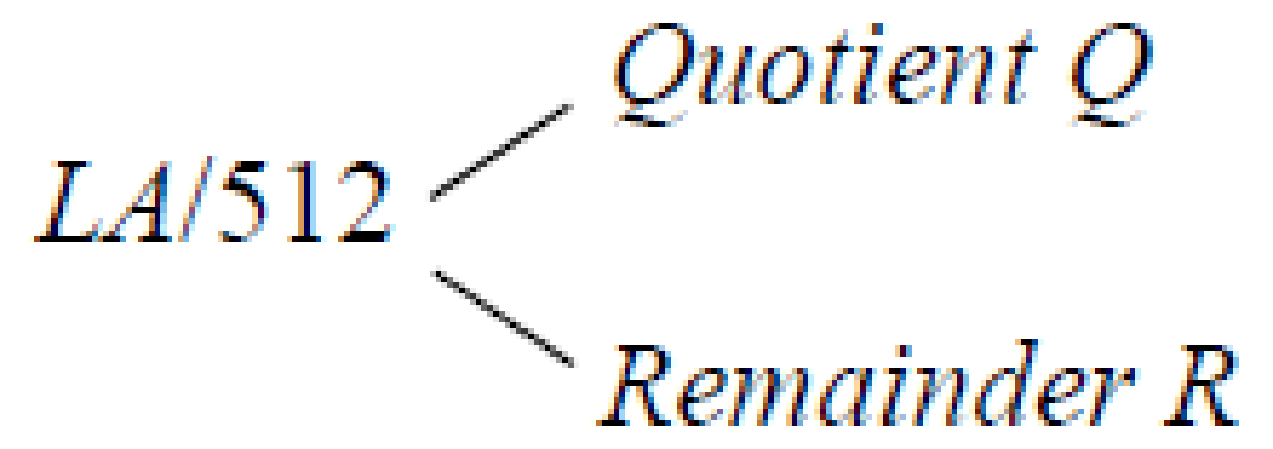
Indexed Allocation - Example
Given a logical address LA of file A, how to map LA to its block address?
Assume the block size is 512 bytes
Block number B: Look up the Q-th entry of the index table to obtain B
Block offset D = R
Number of disk accesses to get the data at address LA
1 access to get i-node address of file A
1 access for reading the index table
1 access to get data for block B

Slide 44
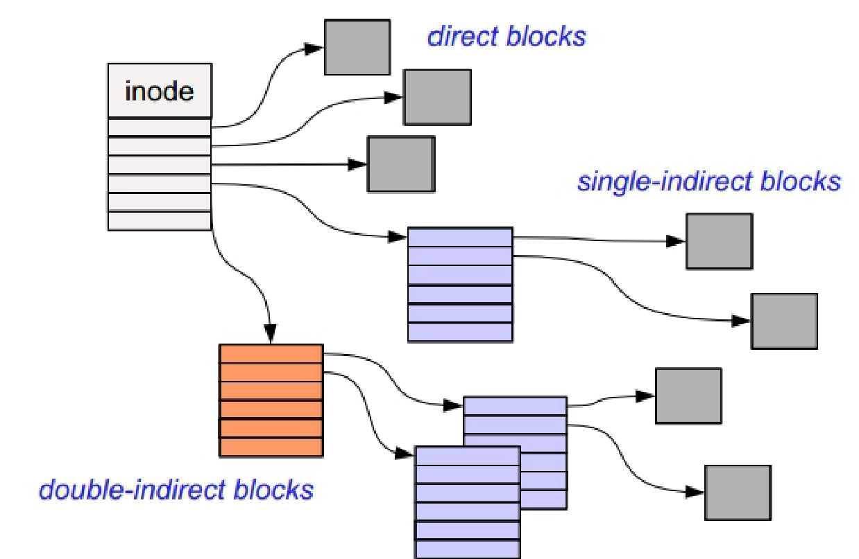
Indirection in Indexed Allocation (1)
i-node can contain a pointer to
direct block (data block)
single indirect
double indirect
triple indirect blocks
…
Allows file to grow and to be incredibly large!

Slide 45
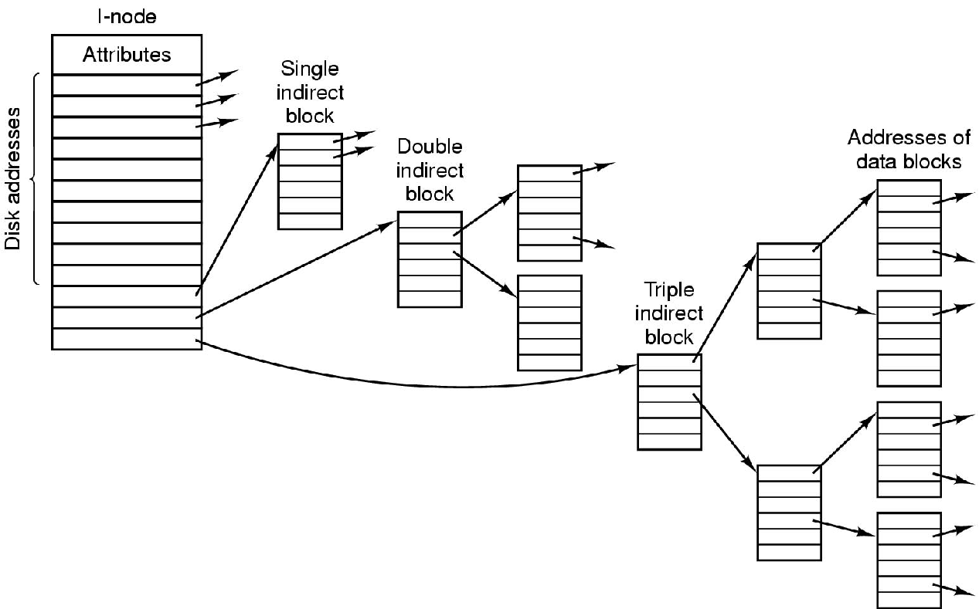
Indirection in Indexed Allocation (2)
A UNIX i-node. (MOS Figure 4-33.)
Notes:
The first N entries in the I-node are direct addresses to support small files

Slide 46
Directories Implementation

Slide 47
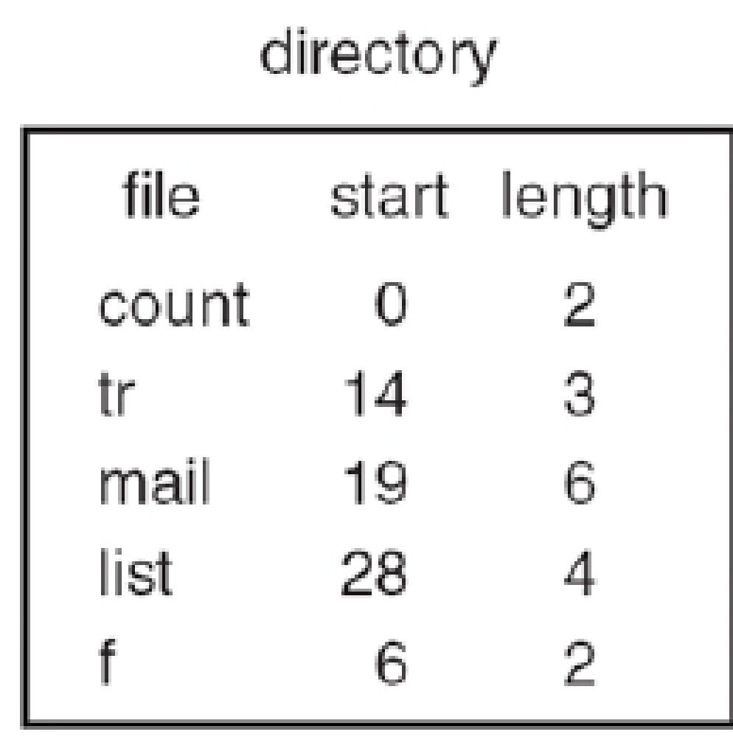
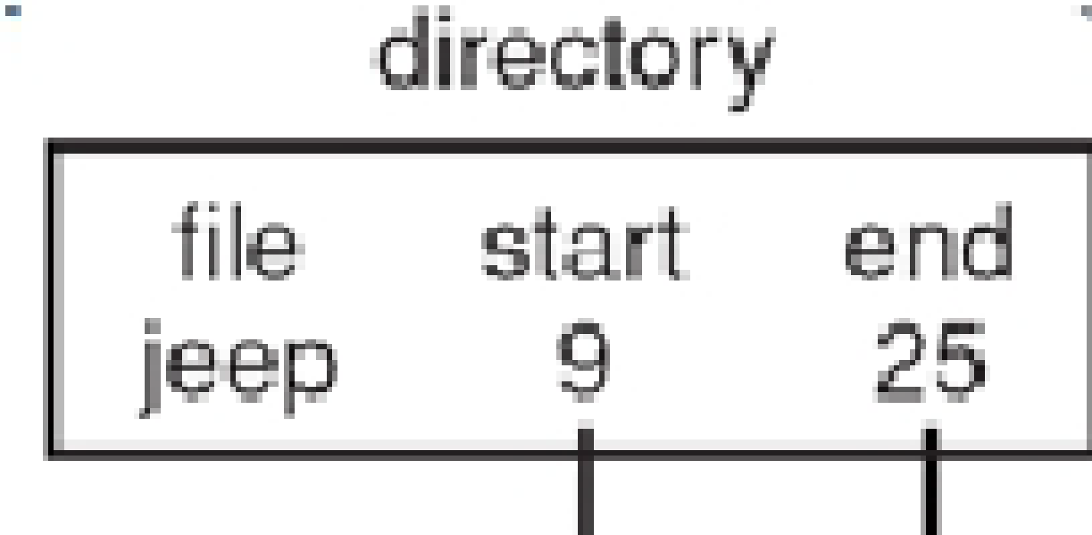
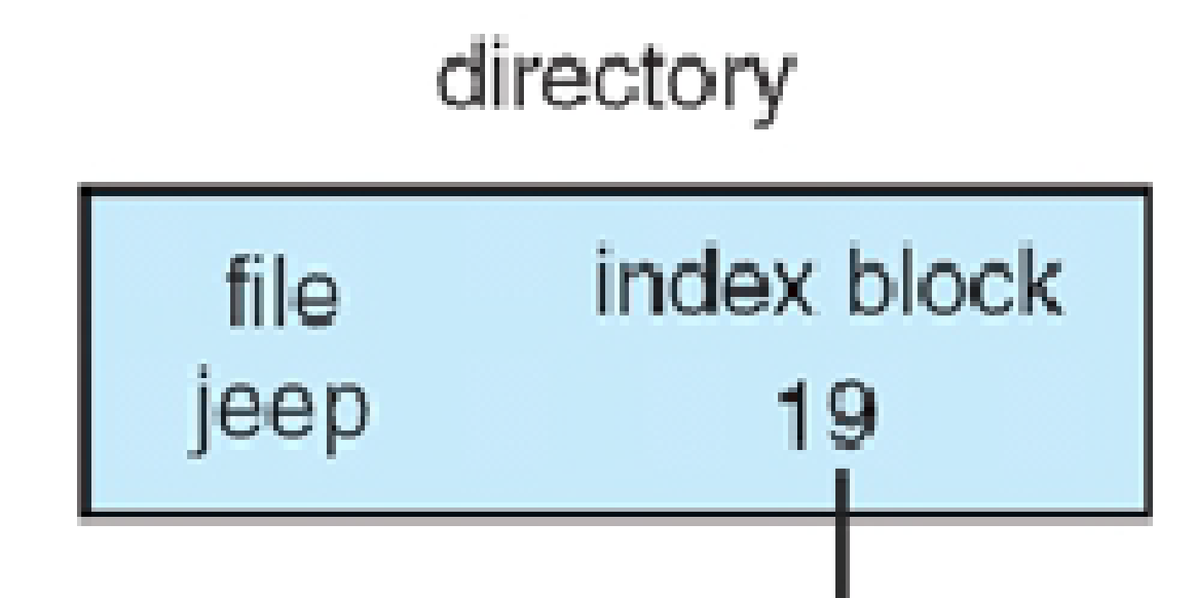
Directories – Mapping Files
Map the file path/name (in ASCII) to …
Contiguous allocation: the start block address of the file
Linked list: the first block of the file
Indexed allocation: the index block
…
(a) contiguous allocation (b) linked list (c) indexed allocation

Slide 48
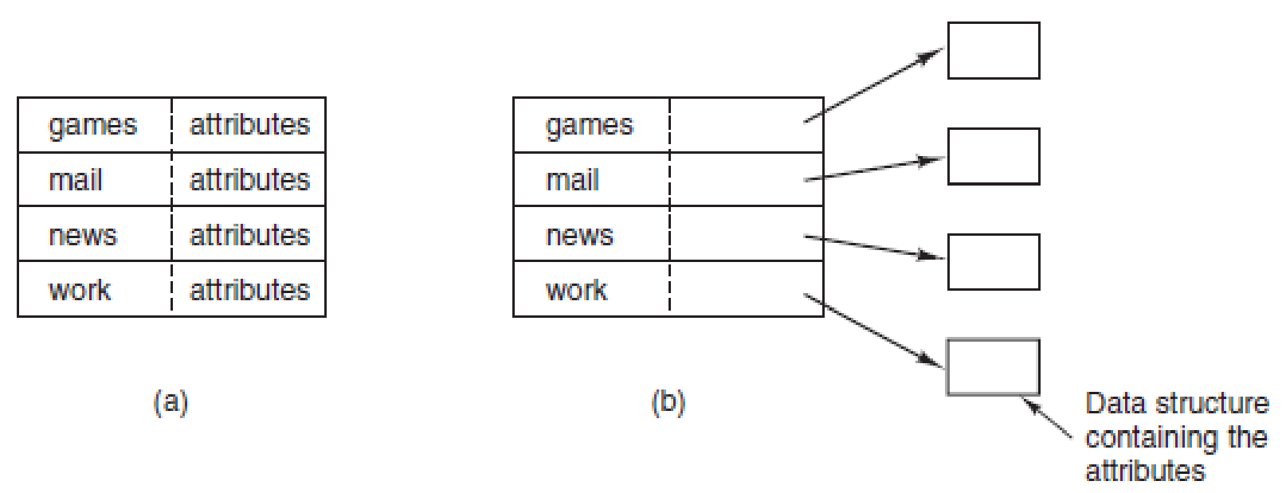
Directories – File Attributes
(a) A simple directory containing fixed-size entries with the disk addresses and attributes in the directory entry. (b) A directory in which each entry just refers to an i-node. (MOS Figure 4-14.)
Notes:
Also for directories you need attributes
closely related issue is where the attributes should be stored. Every file system
maintains various file attributes, such as each file’s owner and creation time,
and they must be stored somewhere. One obvious possibility is to store them directly
in the directory entry. Some systems do precisely that. This option is shown
in Fig. 4-14(a). In this simple design, a directory consists of a list of fixed-size entries,
one per file, containing a (fixed-length) file name, a structure of the file attributes,
and one or more disk addresses (up to some maximum) telling where the
disk blocks are.
For systems that use i-nodes, another possibility for storing the attributes is in
the i-nodes, rather than in the directory entries. In that case, the directory entry can
be shorter: just a file name and an i-node number. This approach is illustrated in
Fig. 4-14(b). As we shall see later, this method has some advantages over putting
them in the directory entry.

Slide 49
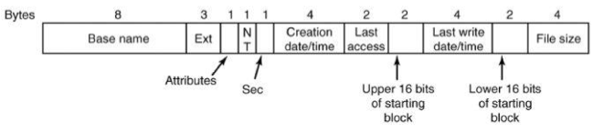
Directories Are Stored as (Special) Files
File contents → directory entries
Example: fixed-size FAT directory entry
Directory blocks include entries for files within them
Directories with many files may span multiple blocks

Slide 50
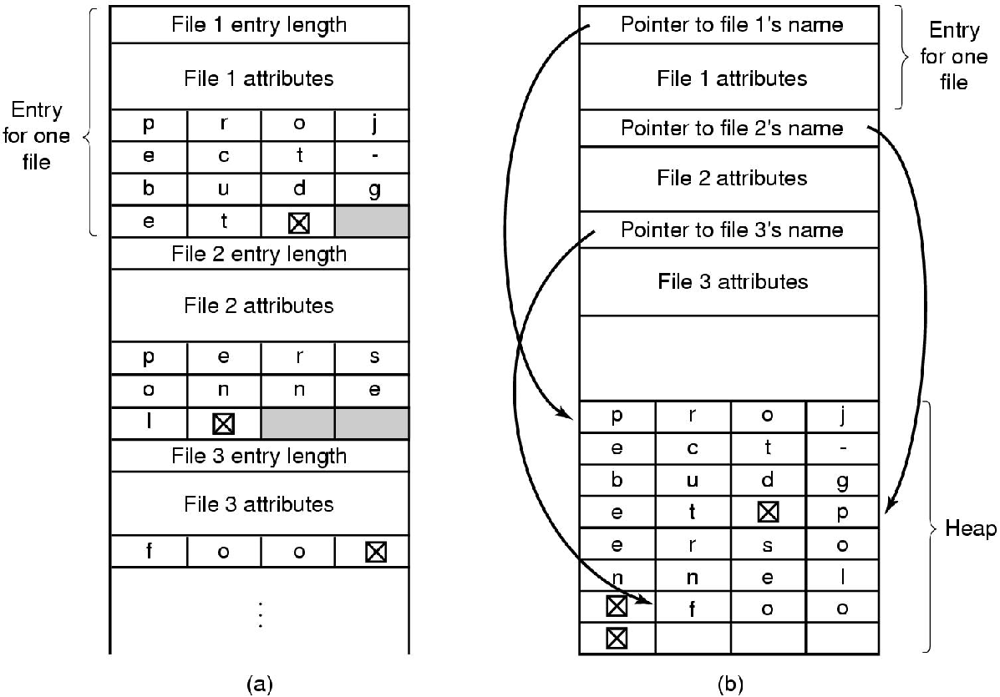
Directories – Long File Names
Two ways of handling long file names in a directory.
(a) In-line.
(b) In a heap. (MOS Figure 4-15.)
Notes:
So far we have made the assumption that files have short, fixed-length names.
In MS-DOS files have a 1–8 character base name and an optional extension of 1–3
characters. In UNIX Version 7, file names were 1–14 characters, including any extensions.
However, nearly all modern operating systems support longer, variable-
length file names. How can these be implemented?
The simplest approach is to set a limit on file-name length, typically 255 characters,
and then use one of the designs of Fig. 4-14 with 255 characters reserved
for each file name. This approach is simple, but wastes a great deal of directory
space, since few files have such long names. For efficiency reasons, a different
structure is desirable.

Slide 51
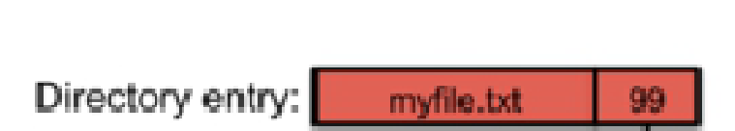
Directories in i-node File Systems
Every file and directory is represented by an i-node
Index node contains two kinds of information:
Metadata describing the file's owner, access rights, etc.
Location of the file's blocks on disk → blocks store directory contents

Slide 52
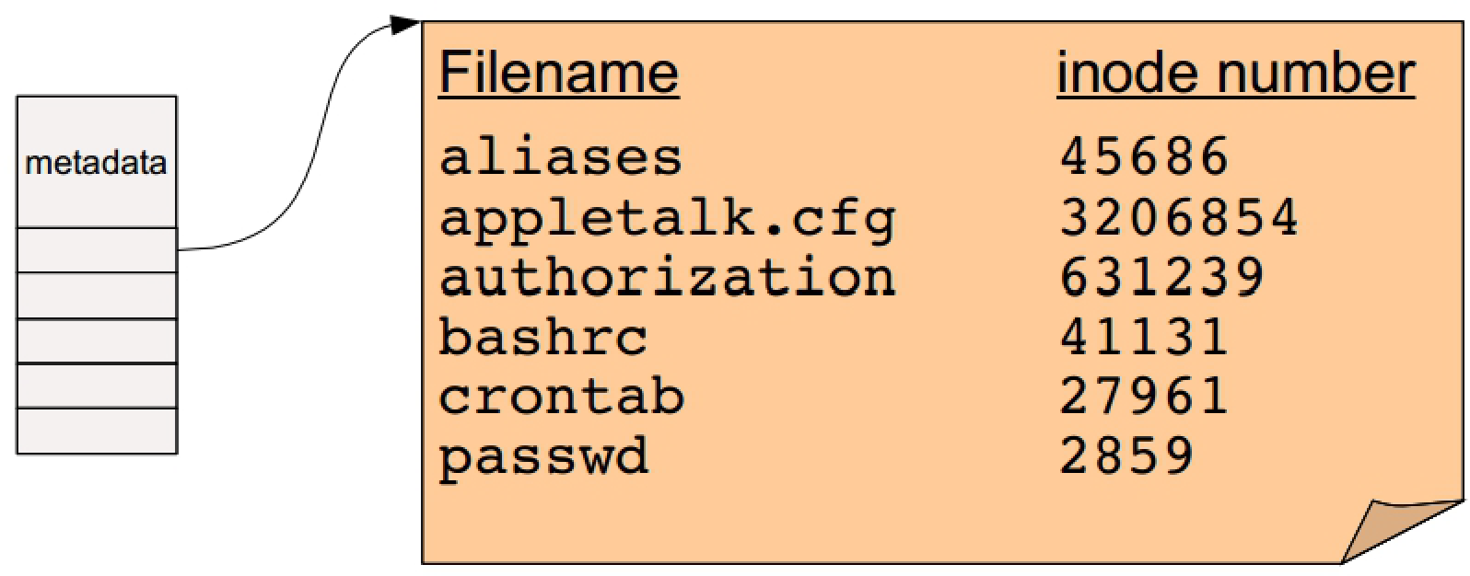
Directories
A directory is a special kind of file that contains a list of (filename, inode number) pairs

Slide 53
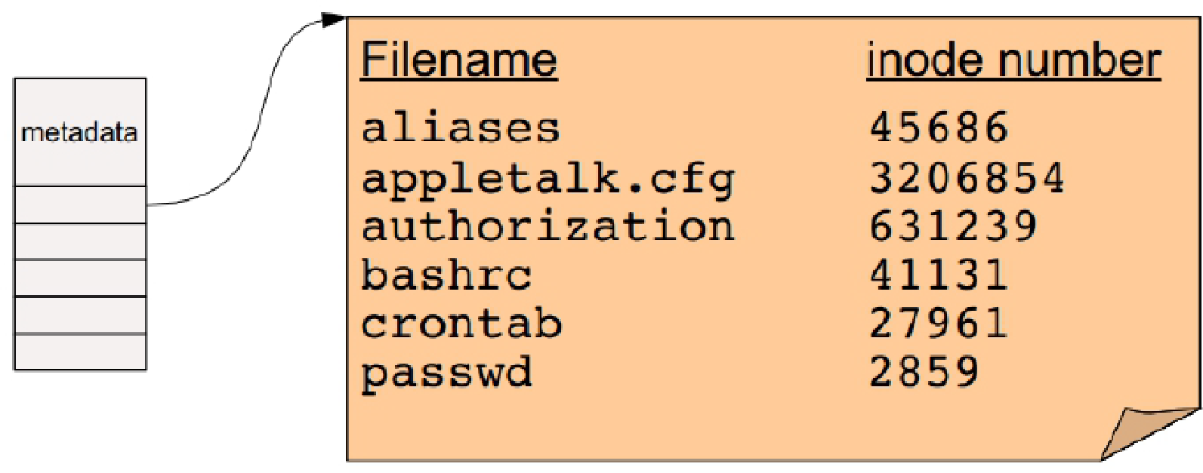
Directories
Questions
How do we find the root directory (“ / “ on UNIX systems)?
How do we get from an inode number to the location of the inode on disk?

Slide 54
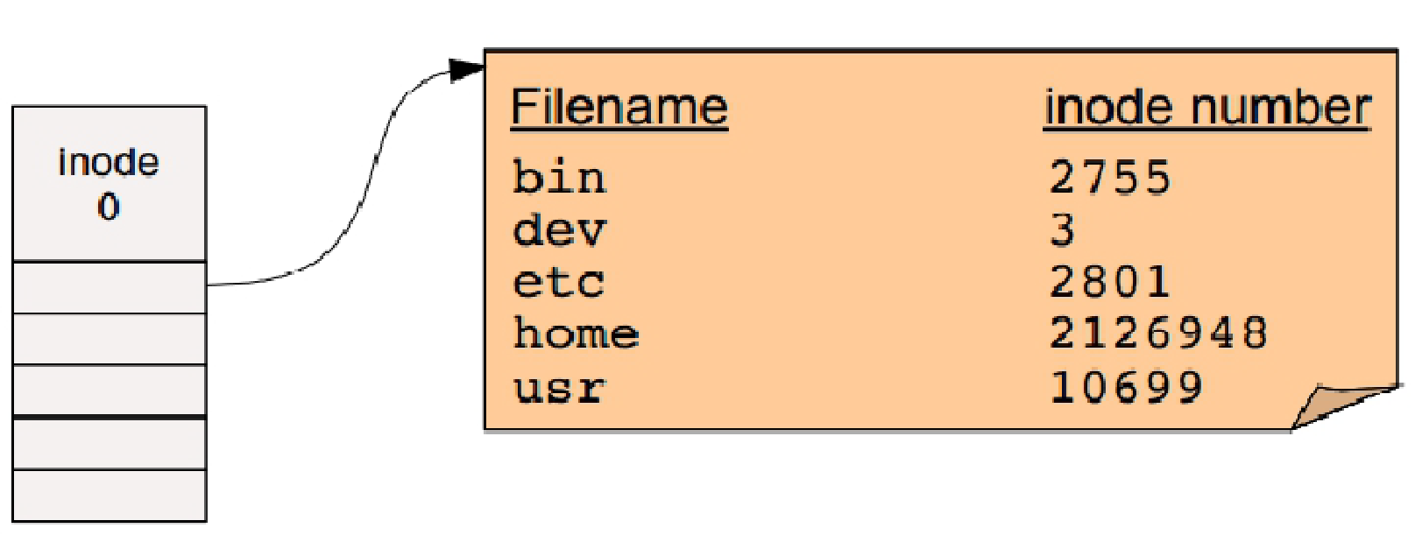
Directories – Root Directory
The root directory is a special inode
Usually numbered 0 or 1

Slide 55
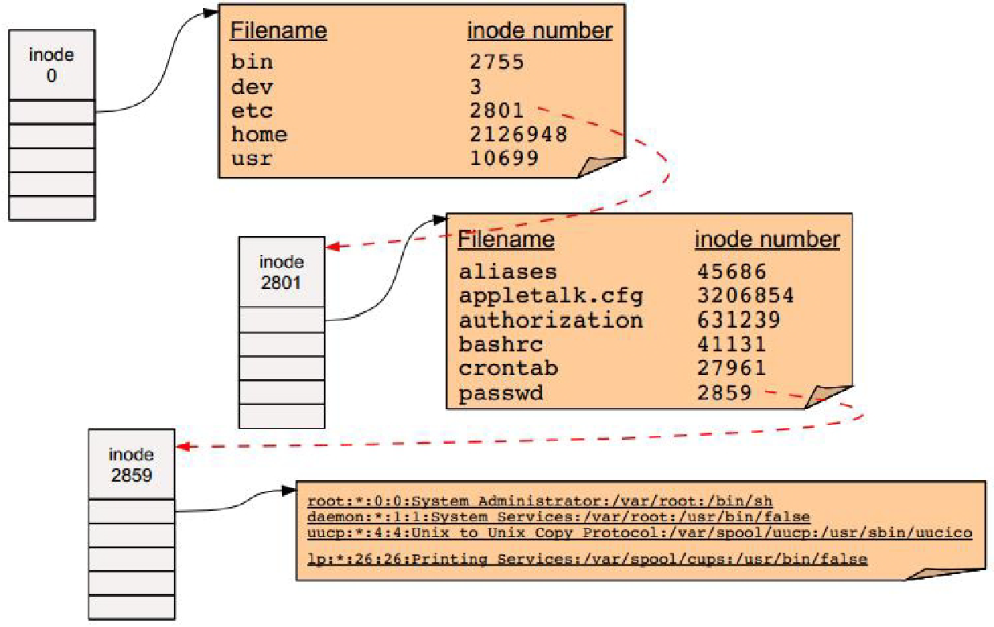
Directories – Pathname Resolution
To look up a pathname “/etc/passwd”, start at root directory and walk down chain of inodes...

Slide 56
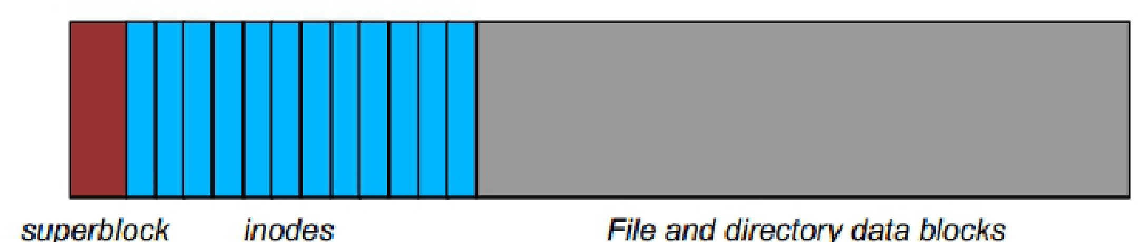
Directories – Locating i-nodes
Question: how do we find the inode on disk?
Basic idea: Top part of file system contains all of the inodes!
The superblock stores important metadata on filesystem layout, list of free blocks, etc.
Easy to compute the block address of a given inode:
block_addr(inode_num) =
block_offset_of_first_inode + (inode_num * inode_size)

Slide 57
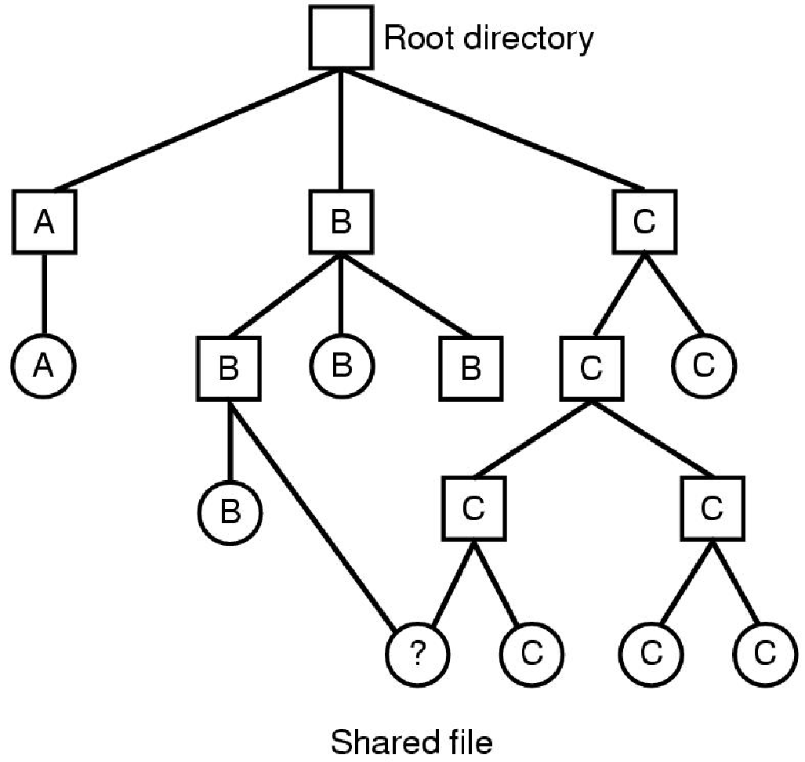
Same File in Different Directories
Convenient for a shared file to appear in different directories
Even belonging to different users
Directory system was a tree, now a DAG
Link
Hard
Soft
(Focus on i-node FS)
File system containing a shared file. (MOS Figure 4-16.)
Notes:
When several users are working together on a project, they often need to share
files. As a result, it is often convenient for a shared file to appear simultaneously
in different directories belonging to different users. Figure 4-16 shows the file system
of Fig. 4-7 again, only with one of C’s files now present in one of B’s directories
as well. The connection between B’s directory and the shared file is called a
link. The file system itself is now a Directed Acyclic Graph, or DAG, rather than
a tree. Having the file system be a DAG complicates maintenance, but such is life.

Slide 58
Hard Links
Directories map filenames to i-node numbers. What does this imply?
We can create multiple pointers to the same i-node in different directories
Or same i-node in the same directory with different filenames
In UNIX this is called a “hard link”, which refers to the specific location of physical data
It can be done using “ln” command

Slide 59
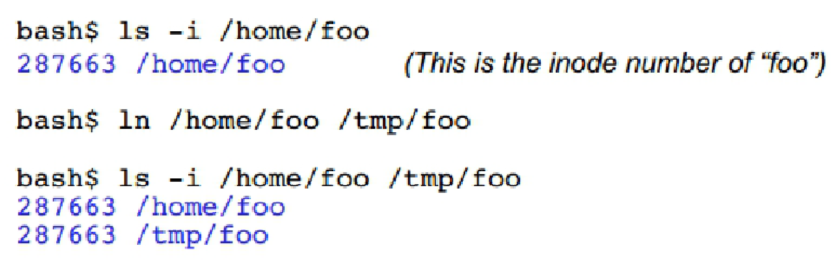
Example of Hard Links
“/home/foo” and “/tmp/foo” now refer to the same file on disk
Not a copy! You will always see identical data no matter which filename you use to read or write the file

Slide 60
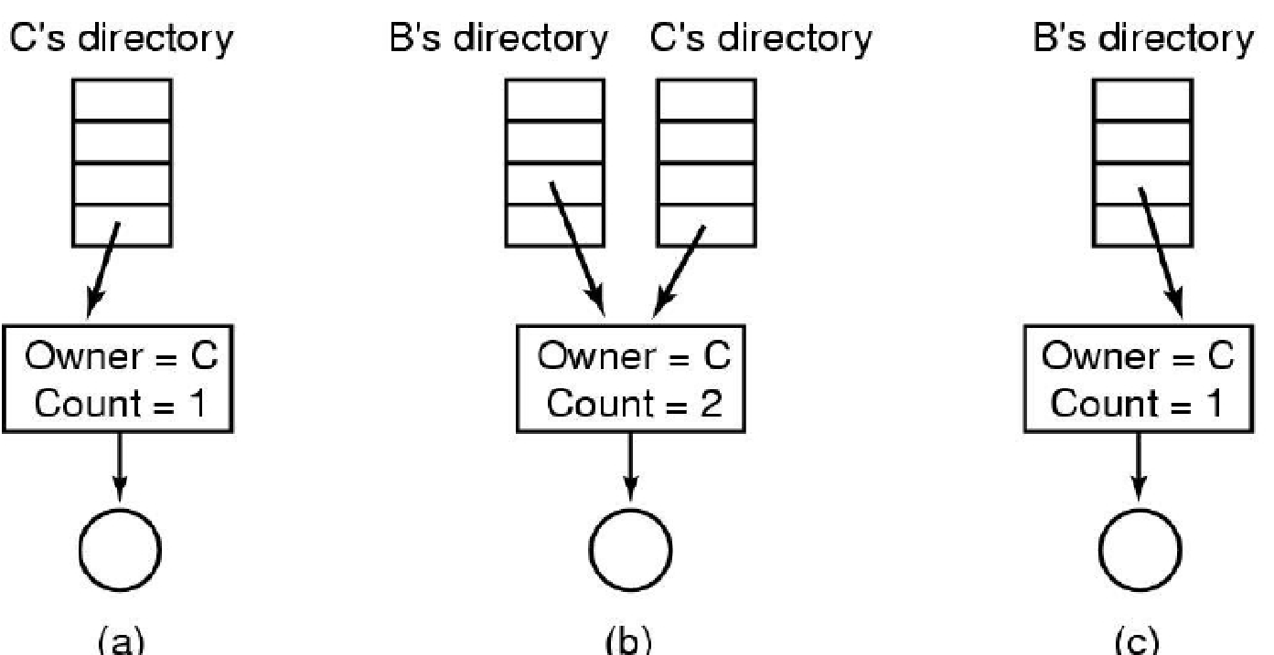
Implementation of Hard Links
(a) Situation prior to linking
(b) After the link is created
(c) After the original owner removes the file

Slide 61
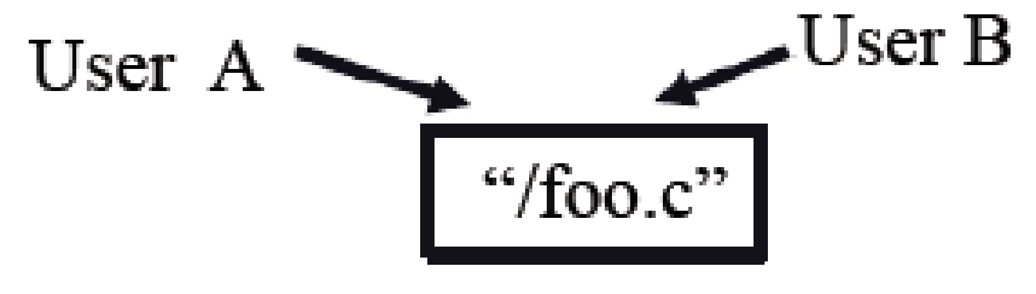
Symbolic (Soft) Links
Symbolic links
A symbolic path indicates the abstract location of another file
Indicated by file attribute (special “sym link” bit set)
During name interpretation, symbolic link is read and interposed into name

Slide 62
Example of Symbolic Links
$ ln -s /path/to/file1.txt /path/to/file2.txt
Above command will create a symbolic link to file1.txt

Slide 63
Implementation of Sharing by Symbolic Links
Only the original file actually links to the i-node
Symbolic links only link to path names, not i-nodes
When the owner removes the file, the link points to non-existent pathname
Disadvantage → Extra overhead to parse symbolic links

Slide 64

Hard vs Soft Links

Slide 65
Virtual File System

Slide 66
Virtual File System (1)
Many different file systems are in use
Even on the same computer
Even under the same operating system
Example, Linux’s ext3 + USB’s FAT32 + CDROM’s iso9660
From the user’s point of view
There is a single file-system hierarchy
Which encompasses multiple (incompatible) file systems
UNIX uses a virtual file system (VFS)
Integrates multiple file system into a single structure

Slide 67

Virtual File System (2)
Operating System
driver
Different disks or partitions
Position of the virtual file system. (Figure 4-18.)
Notes:
Buffer cache is not the page cache – it is the buffer of the disk blocks

Slide 68
Virtual File System (3)
All system calls related to files are directed to VFS
Using standard POSIX calls
Upper interface
The lower interface “VFS Interface”
Calls into file system code
Internally, a VFS is object oriented, key abstractions
Superblock (file system)
v-node (file)
Directory

Slide 69

File-Control Blocks
The logical file system subsystem maintains structures consisting of
Information about a file – file-control block (FCB)
Simplified FCB

Slide 70


File System Subsystem Internals
metadata
metadata
Operations performed when reading the file after opening

